Slide 1
Newham Ageing Well Strategy: Resident Engagement

Slide 2
"It's a vibrant community, but things for older people tend to forget that we were the generation that invented the internet (for example), and we don't just want knitting, bingo or tea dances. We've lived through - and in lots of cases enjoyed - many quite radical changes in our time such as political and social shifts, punk, fashion...and yet now we're sometimes treated as though we were born in the Victorian age. Our bodies may be letting us down, but that doesn't mean our minds should atrophy through lack of stimulation"
Newham resident, Ageing Well Survey, 2021

Slide 3
Contents
Purpose of the Strategy
Resident Engagement
Engagement and Consultative Process
Healthy Ageing in Newham
Priority Areas
Priority Area 1: Information and Communication
Priority Area 2: Home
Priority Area 3: Finance, Employment, Volunteering and Retirement
Priority Area 4: Community, Connections and Neighbourhood
Priority Area 5: Planning and Preparing for Later Life
Characteristics of Survey Participants
Get Involved

Slide 4
Purpose of the Strategy
To improve the health and wellbeing of Newham residents aged 50 and over and reduce health inequalities.
To achieve this, the Council has engaged with residents and other organisations, including the local NHS and voluntary, community and faith sector, to understand:
how residents age 50+ rate Newham as a place to grow older;
what is working well and areas for improvement.
Through this five priority areas have been identified and an Action Plan developed for each. These will ensure the Council and its partners deliver meaningful changes to make Newham a place where all residents aged 50+ can be healthy and age well.

Slide 5
Resident Engagement
Activity | Description | Number of residents involved
Older People’s Reference Group (OPRG) | Engaged group on survey design to ensure the survey collected comprehensive and relevant information and was accessible.
Survey | Collecting data on comprehensive range of issues relevant to healthy ageing. Mixture of multiple choice and free text questions to gather meaningful insights. Promoted through letter posted to every household with someone aged 50+ living there, OPRG, COVID-19 Health Champions, VCFS partners. Residents invited to complete survey online, by post or by phone. | 1500 responses
Focus groups | Exploring enablers and barriers to physical activity and social connection. Facilitated by community researchers, who are Newham residents trained to do peer-led focus groups. | 9 participants; 3 community researchers
Workshops | 1x in-person (4.5-hour) and 2x online (3-hour) workshops to present early draft strategy and action plans based on initial engagement findings and seek resident feedback and input. | 115 residents
Action plan consultation | Draft actions plans posted on co-create and sent to residents (email or post) to seek feedback and input. Group of 145 residents are residents who took part in survey/workshop and opted-in to review draft action plans. | 145 residents + OPRG
Read the supporting document online for more information about these resident engagement activities and insights, which helped shape the ageing well strategy and action plans.

Slide 6
Engagement and Consultative Process
9 participants & 3 community researchers
Approximately 115 residents
Action plans shared with Older Peoples’ Reference Group for feedback
Sent to 145 residents
1500 Respondents
Residents Survey
Resident Engagement Workshops
Shared Action Plans with OPRG
Action Plans Consultations with Residents
Focus Group Discussions

Slide 7
Healthy Ageing in Newham

Slide 8
Newham as a Place to Grow Older
520 residents (out of 1500 who responded to the Ageing Well survey) said Newham is an ‘excellent’ or ‘good’ place to grow older. This suggests Newham has strengths and assets that help some residents flourish and age well.​
​However around two thirds rated Newham as ‘average’, ‘poor’ or ‘very poor’. This demonstrates things can be improved so all residents have the opportunity to age well.

Slide 9
Newham as a Place to Grow Older Cont…
‘Good transport links, many local activities, close to the river and docks, good roads, green spaces. Sympathetic local councillors and opportunities for personal development.’ | ‘There are good things, e.g. access to transport, shops and primary healthcare, but the community feels fragmented and I think it would be hard to be an older person here if you didn't have your own strong family network.’ | ‘The living environment is pretty dirty and polluted. Pavements often have trips in them. GP’s are good. There are no public toilets. More activities for over 50’s.’
‘I choose to make it a good place for myself but I have the privilege of work, a home, family, interests, emotional and physical health, and a spiritual practice. Others may find it hard because of infirmity, poverty, lack of choices, unpleasant neighbours, and/or other factors. I thoroughly applaud the provision of community activities, allotments, sports facilities, parks, etc. It is great that so many religious and spiritual groups are in the area.’ | Women's groups like Cycling Sisters and communal gardening are showing the way to healthy living and exercise across cultural boundaries. Youngsters in this borough are growing up expecting better stuff. I think Newham is failing to react practically and urgently to the climate and health crises that are building up. Many of our councillors are acutely aware of it, and I can tell they are frustrated at the slow pace of progress. | ‘Many people here live in poverty and have poor access to good housing. We have a big problem in Stratford of slumlords who strip out community spirit for profit. The Olympics & related developments destroyed long-standing communities and there is a poor grasp of the area's histories and the people who are part of those histories. I am worried about gentrification making things worse (see the Runnymede's recent report on that). I don't think older & the many younger people in the borough are well integrated, partly because younger people are really struggling to get by.’
I love Newham and think it is fantastic. People are lovely, the mix of cultures is great, and some of our school pupils and schools are outstanding, despite severe deprivation in the borough. The history of the docklands, the waves of immigrants and what we have brought to Newham is incredible. | The council tries to encourage people to a more healthy life style by sending texts & emails about eating better & taking more exercise. But it seems to me it only reaches the already converted, it needs to reach a much wider audience, especially those who are not already taking exercise or who have bad eating habits. Less fast food outlets may also help. | Health-wise, Newham is the most toxic and polluted areas in the UK, with the highest rates of obesity, COPD and asthma, including children - who should not have these diseases! You do not do enough to stop people being reliant on their cars, even though most residents don't even own or use one and our public transport system is fantastic.
I’ve found the communication excellent during the COVID emergency and in the initial stages was helped greatly by regular telephone calls while isolating. The provision of food parcels was exemplary. In addition, the availability of Leisure and cultural facilities in the Borough is excellent. I get the impression that Newham cares for its older residents. | Pros - pretty good adult social care & some attempts to (pre covid) run sessions & classes for over 50s. Fairly good transport links accessible for all. Cons- Continuing erosion of social indoor Public spaces means above classes mentioned, are often in cramped conditions. Classes organisation often not overseen & age restriction abused by under 50s. Also less places to meet up with others. Leisure facilities planned to be shut down and replaced with flats. Overcrowding & obesity. Constant changes to bus routes and diversions not conducive to the elderly. Often left to individuals to contact TFL, when council intervention would provide a stronger voice. | It is not a good environment for old people, the streets are always full of rubbish & people fly-tip everywhere in the borough. The GP surgeries in the area are very unhelpful especially during the pandemic, even now you still have to book online through badly designed portals, and this is difficult for older people who did not grow up using computers and technology. The online services for the borough are confusing and haven’t been designed with the users in mind.

Slide 10
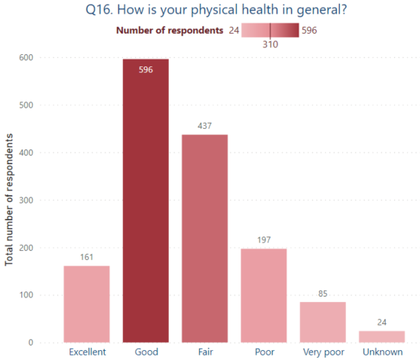
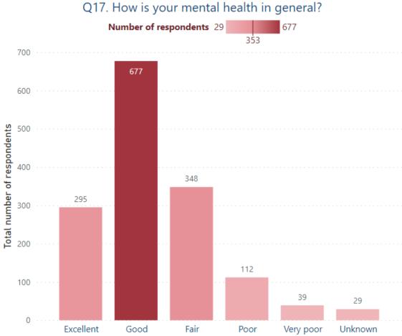
Healthy Ageing
A large majority of the respondents reported as having good physical health.
A large majority of the respondents reported as having good mental health.

Slide 11
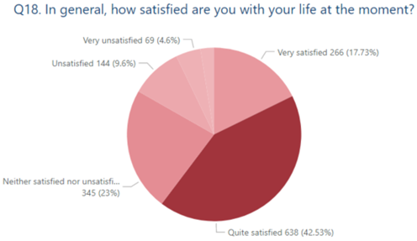
Healthy Ageing Cont…
Majority of the residents responded as being quite satisfied with their life at the moment.

Slide 12
What Does Ageing Well Mean To You?
Keeping physically fit so that I can take care of myself and my needs, staying mentally well, continuing to be engaged in life, having a good network of contacts, continuing to have a part to play in society and things to look forward to.
Being able to lead an independent, active life. Not being hindered by health issues. Enjoying the range of activities available in Newham / London.
Being fit and well enough to live independently, maintain an orderly house, keep sociable and not lonely, and enjoy favourite pastimes that involve physical and mental activity and going out from time to time. Being able to obtain the services that may be required from time to time as aging takes its toll.
Keeping fit, healthy. Maintaining a healthy, active lifestyle. Feeling part of my community and contributing to my community. Being valued, respected and feeling safe.
Being able to continue with an active and stimulating lifestyle and have a sense of belonging , valued and not being cast aside. Value a lifetime of learning and experience.
Being reasonably fit and well and able to get about and look after yourself and help those closest to you. It also means being financially independent with somewhere decent to live.
Good health, enough income to be comfortable, friends, relatives, mobility, nice environment, good quality housing, food, local services.
Mobility; access to rapid low-level and urgent level health care; living in a safe and pleasant environment (low traffic levels, well-maintained parks and walking areas etc); maintenance of basic home comforts
Able to do what you wish to; living in good health; neither having to live in poverty nor having to look after every penny; having a purpose and finding life enjoyable.
Feeling safe when walking the streets. A supportive local community where I can help and be helped. If required support from local government professionals with help and advice with age related issues. Feeling safe in my home.
Being fit and well enough to look after myself and others, to carry out activities I enjoy, and to live life to the fullest. Also, to have enough money to live on and a safe, warm place to live.
Remaining in good health, being physically active and being financially secure and independent.
Being reasonably fit and well and able to get about and look after yourself and help those closest to you. It also means being financially independent with somewhere decent to live.
Maintaining good physical and mental health, retaining a youthful and open outlook and engaging with the community.
Being able to carry out the normal functions of daily life with minimum impediments from poor health, lack of social contacts or financial barriers.

Slide 13
Priority Areas
Working with residents and stakeholders, the Ageing Well Strategy sets out five priority areas and a co-produced Action Plan for each.
Information and Communication
Positive Visibility of Healthy Ageing & older residents as consumers & active participants
Effectively Communicating Information to Residents – Helping Them To Make Informed Decisions
Home
Warm Home
Living Well with Dementia
Safety, Maintenance, Adaptations and Independence
Digital Inclusion
Enabling Residents to Communicate What They Need and Their Preferences
Specialist Housing
Connected and Integrated Communities
Community, Connection and Neighbourhood
Planning and Preparing for Later Life
Income Maximisation
Employment Opportunities, Variety and Support
An Urban Environment that is Healthy, Accessible, Inclusive and Supports Independence
Local Services and Activities
Safe Neighbourhoods
End of Life Care
Eating Well
Communication
Homelessness and Rough Sleeping
Domestic and Sexual Violence
Volunteering Opportunities and Variety
Advanced Planning
Primary Care
Integrated Care
Adult Social Care
Living Well with Chronic Conditions
Finance, Employment, Volunteering and Retirement

Slide 14
Theme 1: Information and Communication

Slide 15
Summary
Many older residents said they do not feel visible, especially as Newham is a relatively young borough. This suggests the Council and its partners could do more to promote healthy ageing and ensure communications are diverse and inclusive of residents aged 50+.
Throughout the engagament, residents demonstrated that they were unaware of certain services / support that is available. This suggests the Council and its partners could promote its services more widely and in more accessible ways to reach a greater proportion of residents aged 50+.
Many residents said they do not know who to contact about the services / support they want to access, and that they find the ways of getting in touch inaccessible. This suggests the Council and its partners could improve the ways residents are enabled to get in touch.
Digital exclusion is a barrier to independence and engagement for many residents. For some this has worsened as more services have moved online. This indicates there is a need for information and communication to be available in a range of formats and that some residents may benefit from digital support.

Slide 16
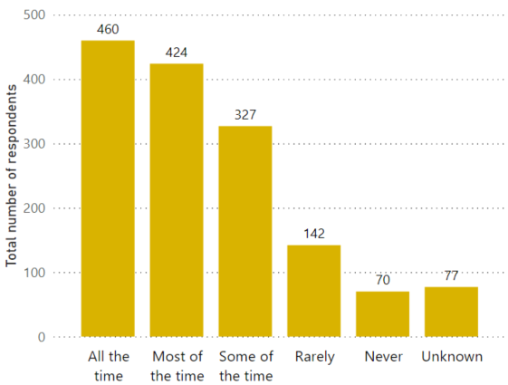
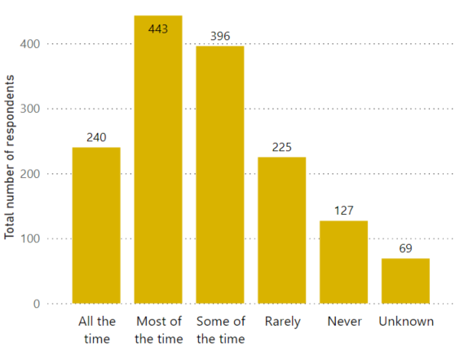
Survey Results
Are you able to communicate your needs and preferences to others (e.g. local services, local community)?
Are you able get the information you need to have good health and wellbeing?
The highest number of respondents felt that most of the time they were able to get information that they needed, 240 felt that they got it all the time and 396 felt that they only got it some of the time with a small number also mentioning that they rarely got it or never got it.
Majority of the respondents (n=460, n=424) felt that they could communicate their needs & preferences to others and only a small number felt that they could not.

Slide 17
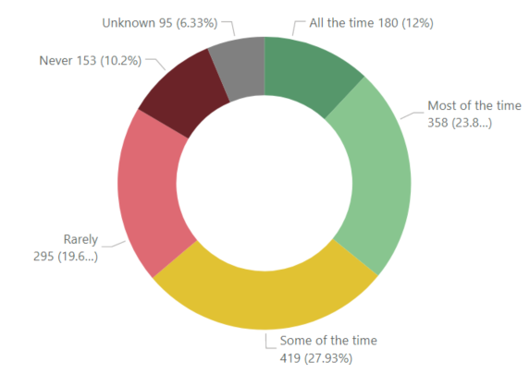
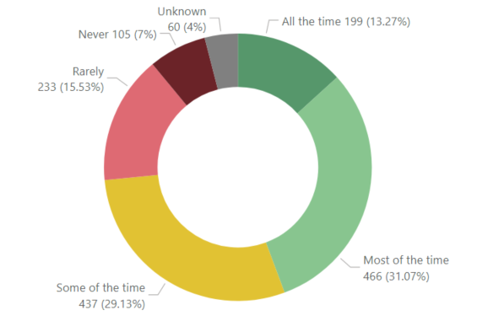
Survey Results
Are you able communicate easily to the council any concerns or questions you have?
Are you able to easily get the information you need about council services you want to use?
The highest percentage (27.93%) of the respondents felt that they were only sometimes able to communicate easily with the council regarding any concerns or questions that they had.
The highest percentage (31.07%) of the respondents felt that they were able to get information from the council regarding services whereas, a close percentage (29.13%) felt that the same only some of the time.

Slide 18
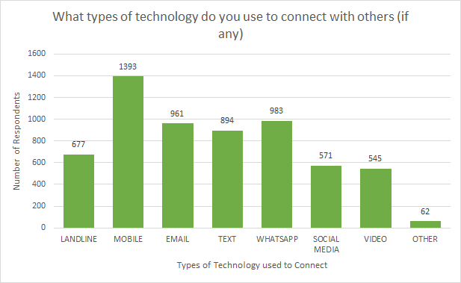
Survey Results
The top 3 types of technology used to connect with others were mobile phone, WhatsApp and e-mail.

Slide 19
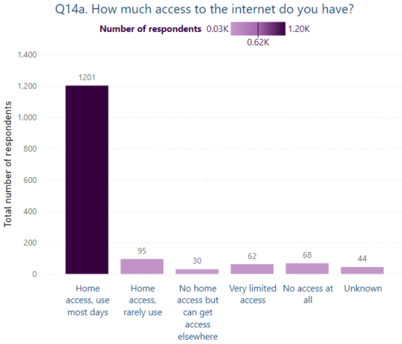
Survey Results
Vast majority of the residents said that they had home access to internet and used it most days.

Slide 20
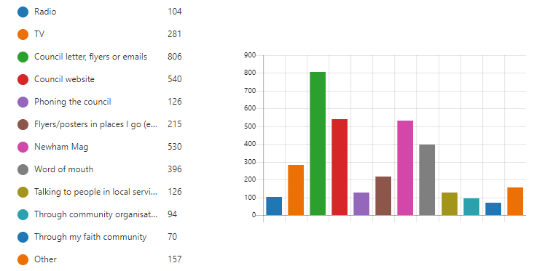
Survey Results
Where do you usually get your information about your local area and services? (select all that apply)
Number of Respondents
The top 3 means of receiving information about their local area & services were; council letters, flyers or emails, council website and Newham Mag.

Slide 21
Voice of Residents – Survey
‘Although some services are available, the shift to accessing everything online excludes many people or takes away independence. Even simple things like no-cash pay by phone for car parking is resulting in some older drivers avoiding visiting places they normally would.’
‘Parking visitor passes are now online only. You stopped the yellow paper visitor passes. I cannot use the internet/smart phones etc… You are making it more difficult for older people
‘A LBN website dedicated to residents wellbeing and activities, where you can register your individual interests, read about activities and get contacted with information specific to your needs advising what's on, when, and how to participate.’
‘Provide a specific support for Council Tax bill, improve their phone Customer Service (as always have bad experience, as agents are not trained properly to be more tolerant and patient with elder people and to provide with correct information according to a specific need).’
‘I am 75. I do not receive any information from the Council - apart from Council Tax, elections and parking permits. We have not received the Newham Mag for over a year - and therefore do not receive any information about Council services / what is going on in the Borough.’
‘The Council telephone line has made it almost impossible to speak to a human being about a query, leaving us in a loop of automated choices that lead nowhere, or divert us back to the website where information and services are not always easy to access. Orange bags, for instance!’
‘More communication by council at local level of all activities taking place. More information in various formats e.g. for the disabled and BME.’
I find the Newham website very difficult to use and impossible to be able to talk to a person about concerns or always find the person who can’t help and am sent on a goose chase around departments, where is never anyone’s job. When you do successfully use the website the document you have completed disappear when submitted and you never hear what action is being taken or completed. You have to do another document to find out what’s happening.
‘I feel also as I am lost in the 'future' all around me I see technology and I have no idea how to use any of it so also having even a leaflet to show me how to use say a iPhone could extremely help.’

Slide 22
Voice of Residents – Workshops and Consultation
Make better use of citizens’ assemblies.
Clearer access to activities and information and making calling easier e.g. reaching out to organisations and departments.
A directory to advise residents where they can get certain advice or services from, it could be online banking or other online services accessing problems.
Better communication and advertisement (in-person + not on the internet)
People need to know how to get in contact with their councillors.
Better access in being able to get through the Newham Website.
More and more channels for communication and of varying types because community assemblies and meetings are not enough.
Make sure the council videos are visible as not everyone checks their official YouTube or Twitters.
No one supported me when I lost my husband in March 2021. I researched on-line, made phone call to get support. Then was told there is a 6 months waiting list…

Slide 23
Priority 2: Home

Slide 24
Summary
While many residents said they feel safe and comfortable at home, a significant number did not. The characteristics of the home and surrounding neighbourhood may contribute to this. For example, while some housing blocks create a sense of community and safety, others attract antisocial behaviour which can lead to residents feeling unsafe and isolated. This suggests approaches to design of homes and the surrounding environment can improve safety and comfort at home.
Many residents feel at risk of being targeted for fraud, including email, telephone and face-to-face scams. This can lead to residents feeling anxious, isolated and concerned about who to trust.
Many residents do not know what the different housing types are available, including specialist housing for older people. Greater integration of specialist housing into local communities, and awareness among residents, may build community connection and support some residents to move into more suitable accommodation as they grow older.
Many residents said their home meets their needs; some have taken steps to adapt their home to aid their independence as they grow older. However some residents may benefit from more support or signposting to services for adaptations or equipment that would make daily living activities easier.

Slide 25
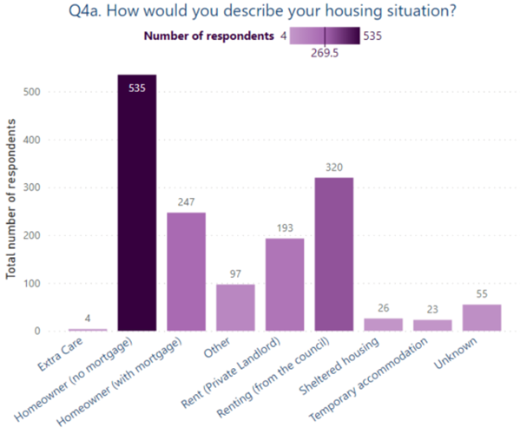
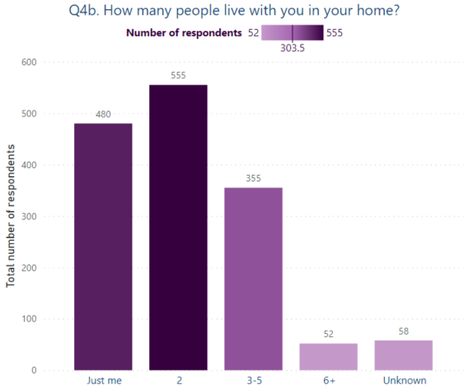
Survey Results
A significantly high number of respondents (n=555) 2 people live with them in their homes along with (n=480) that said it was just them.
A significantly high number of respondents (n=535) were home-owners with no mortgage.

Slide 26
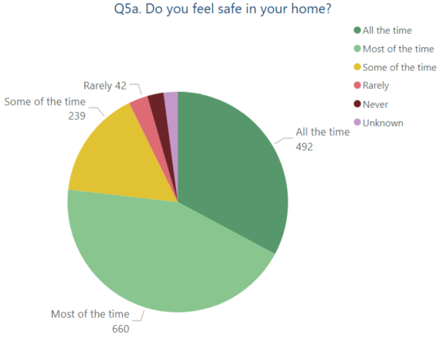
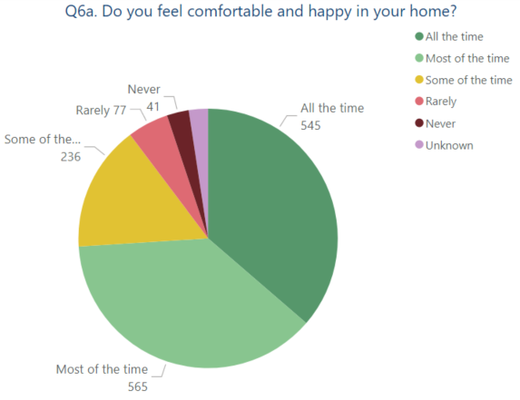
Survey Results
Do you feel safe in your home?
Do you feel comfortable and happy in your home?
A highest percentage of the respondents did feel safe and comfortable in their homes either all the time or most of the time. Feeling of safety all the time, ranked slightly lower in number than feeling of comfort all the time.
Many things can help us feel comfortable at home – for example: enough space; everything works and things are in good condition; clean and tidy; the right temperature; enough light; easy to move around inside and get in and out of the doors; easy to manage with daily activities and odd-jobs.

Slide 27
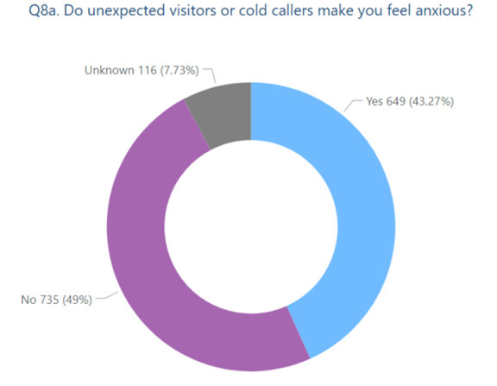
Survey Results
49% of the residents mentioned that unexpected visitors or cold callers did not make them feel anxious, however, an almost similar percentage of 43.27% mentioned that it did.

Slide 28
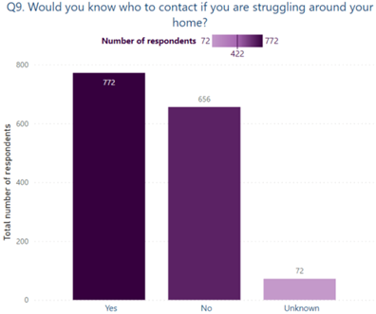
772 of the residents mentioned that they knew who to contact of they were struggling around the house, however, just a slightly smaller number of 656 mentioned that they did not.

Slide 29
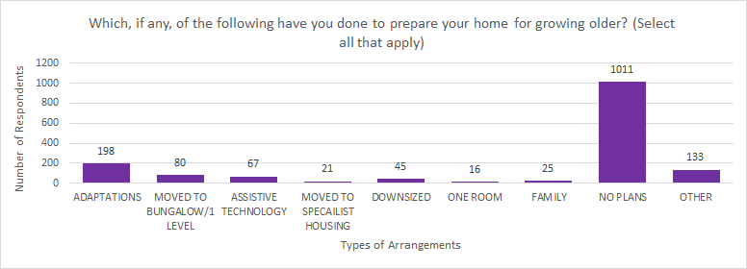
Survey Results
A significantly high number of respondents (n=1011) had made no plans to prepare their homes for growing old.

Slide 30
Voice of Residents - Survey
‘The Borough appears to have become a 'buy to let' haven, so people are transitory, living in poor rental housing in poor conditions, possibly being exploited, because there are no controls over this business model. I don't even know how buy to let landlords or properties are monitored to ensure safety in living conditions, whether they pay a fair share of local taxes to reflect that their business can be high polluting of the environment, due to dumped furniture, mattresses etc.’
Antisocial behaviour, littering, street crime, knife crimes, theft incidents, youngsters smoking weed and drinking in the area and lack of enough security officers make residents feel insecure in their homes. CCTV, well-lit area, police or council personnel appointment, good neighbours, security systems installed in their homes would make people feel safer in their homes.
There is no provision for older residents’ welfare and health care provision. In cold winter of the day’s months, older people with health problems are forced to confine to their bedroom. It is a lonely solitary life. Getting shopping done and preparing meals and other essential household chores takes most of the day.’
‘Often we need small jobs carried out but find it difficult to a trustworthy and reliable operative to carry out work (for which we are, obviously willing to pay). It would be great if the Council could provide elderly residents with a list of local tradespeople who will do odd jobs, painting etc.
I have had 2 break-ins since moving in here and have had to install security bars on my window and a security gate - all paid for on my disability benefit. No help by the Council which is the landlord.
‘Have a housing policy which provides opportunities and encouragement for older people to live together independently (for example promoting community housing projects).’
‘My home isn't suitable for my physical needs. There isn't enough room for my mobility equipment and this isn't taken into account for housing - ideally I'd have an additional bedroom for mobility and physiotherapy equipment.’
‘Use the approach of children visiting care homes. This has been shown to benefit the 'elderly' by stimulation and connect with the real world to increase activity participation. The children benefit from elder interaction - itself sometimes lacking - transition/learn skills/social interaction with elders.’

Slide 31
Voice of Residents – Workshop and Consultation
Having uniformity and a sort of equivalence across the borough in terms of cleanliness and better lighting.
Segmentation needed around council vs private rented sector and different levels of finance around these.
What about help for residents with gardening and private areas that may need maintenance.
More flexible care support options in our homes.
Maybe have an advocate to help residents when they have building work done/handy person service.
Domestic care and support options
Mobile warden schemes to visit the elderly in their homes and see if they have any needs.
Including a booklet on how to safeguard your home may be a better option than setting up a display home.
I suffer from chronic sciatica and would welcome the courses to help manage the pain

Slide 32
Priority 3: Finance, Employment, Volunteering and Retirement

Slide 33
Summary
Many residents described financial insecurity and requested greater support for financial planning, navigating financial and social support processes, and maximising income. Our Newham Money can pay a key role in this.
On employment, residents said older employees can face discrimination at work, such as being overlooked for promotions or new roles due to age. Some residents also talked about challenges at work related to growing older such as symptoms from the menopause, difficulty doing physically demanding jobs, or health conditions preventing them from working. These can go unrecognised by employers or be a source of stigma. This suggests employers could do more to support people to stay in good quality work until retirement.
Many residents expressed a desire to volunteer or take up new work, using their skills and experience. Many also talked about wanting to develop new skills and continue learning. Increasing these opportunities will benefit individual residents and communities and help develop an inclusive local economy.
Residents described the ways they have planned for retirement. However many indicated they have not made retirement plans, including paying into a pension. This has implications for residents’ opportunities to age well in retirement. Through delivering the Strategy we will increase the support available to help residents plan for retirement.
Many residents described enjoying or looking forward to retirement as a time to pursue activities and hobbies. However not all residents have the same opportunities. Through the Strategy we aim to increase opportunities for all residents to be active and take part in society regardless of their age or life circumstances.
Income, work and health and linked. Good quality work and enough money support good health, and good health supports people to work and earn. Improving health and addressing health inequalities through the ageing well strategy can deliver long-term improvements to employment, income and the local economy.

Slide 34
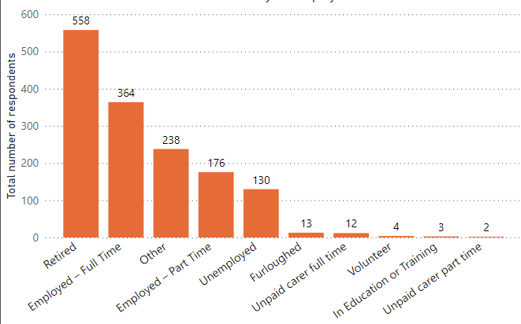
Survey Results
What best describes your employment status?
Measures workplaces should implement to become more welcoming to older workers
810 of the respondents said that workplaces should have flexible working for older workers, followed by 700 that said there should be part-time roles & 525 said re-training schemes would be beneficial.
The highest number of respondents were retired, followed by a slightly lower number of respondents who were employed full time.

Slide 35
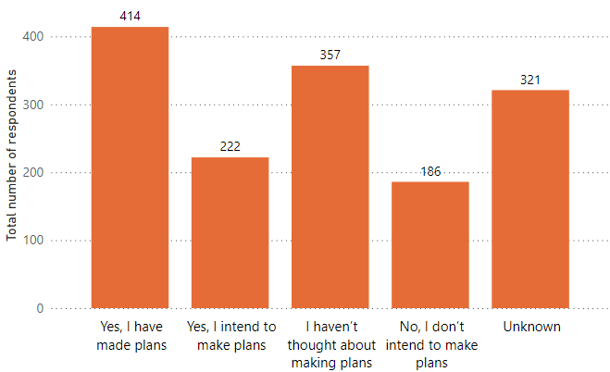
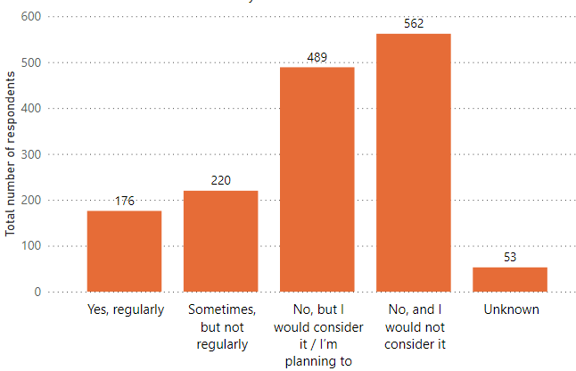
Survey Results
Have you made or do you intend to make any plans for retirement?
Do you do volunteer work?
Highest number of respondents (414) said that they had made plans for retirement already, followed closely by (357) the ones that said they have not thought about making plans.
Highest number of respondents (562) said that they do not do volunteer work, nor would they consider doing it, followed by number of respondents (489) that said they do not do volunteer work but would consider it in the future.

Slide 36
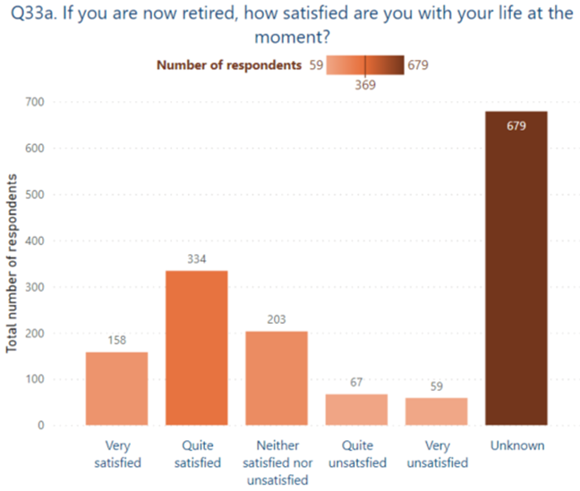
Survey Results
Of those who responded, most residents said they are very or quite satisfied with their life. However a significant number reported being neutral or unsatisfied.

Slide 37
Voice of Residents - Survey
They should stop cutting vital services and stop charging. Pensioners who have worked hard all their lives for services that they feel because they have a pension they now spend it on services that people who never worked and therefore don't have to spend a penny for.
‘Drop-in clinics offering advice on financial matters. Providing services at a range of times so that they cater both for those who are still working and for those who are retired.’
‘People should have enough pension to live on without working until they drop’.
‘Retirement doesn’t seem to exist but reskilling and employment opportunities for older people are thin on the ground.’
‘Council could arrange some activity some voluntary work will help for mental and physical development.’
‘Providing education to the under 50s, initiatives to tackle crime for examples prostitutes, consuming alcohol on the streets and drug taking’
‘Lower council tax for over 65's, which would stop some monetary worries, have free transport links to leisure centres - collect people from home and return to home.’
‘I feel older people are being left behind, meaning there are significant issues around poverty and inequality affecting older people's health and wellbeing.’
‘Train existing staff in awareness and support skills of older workforce; there is too much ageism, especially in schools.’
‘Elderly people are not welcome in the workforce unless it is a contract worker on a as is basis - that way they avoid paying towards a pension it is a scheme that is well known amongst agencies.’
‘The key problem is employer perceptions of potential value.’
‘See Barclays Able to Enable Internships and Bolder Apprenticeship Schemes.’

Slide 38
Voice of Residents – Workshops and Consultations
Having a range of opportunities depending on peoples’ abilities e.g. If someone is house bound.
Better inclusion for all LGBT residents as activities for them are non-existent.
Information to provide breadth and depth of the roles available for volunteering is important.
Covers everything but if there is room then to provide funding opportunities for older people looking to learn new things/take courses or even start a business.
Advise on retiring early due to illness may be useful to have.
Access to training and relevant roles for the future. Need to make people more aware of where to go.
Financial security and information on how to avoid scams.
We are particularly interested in finding opportunities for educational volunteering, notably for elderly people to help young children with reading; and to tell older pupils about local life during their younger years

Slide 39
Priority 4: Community, Connections and Neighbourhoods

Slide 40
Summary
Residents strongly communicated that they would like Newham to become a healthier and more people-friendly place, such as having cleaner air, being easier to get around, having more healthy food options, and public places being more appealing to spend time in. The Strategy is linked to wider programmes of work across the Council to address these issues.
Many residents said barriers to travel can limit their independence. The actions in the Strategy aim to enable residents to travel actively and independently and to support residents to use transport-related services and technology, such as concessionary travel and online parking systems.
While many residents said they feel safe in their local neighbourhood, residents also strongly expressed the need to improve community safety and make Newham a place where all residents can feel safe. The Strategy aims to address safety issues that older residents face, and fits in with a wider programme of work to improve community safety for all across the borough.
Residents highlighted that social connection is essential for wellbeing and healthy ageing. While some residents said they have enough social contact, many said they do not, and the COVID-19 pandemic may have worsened this situation. A range of approaches is needed to improve social connection among older residents, including creating more opportunities for residents to build and sustain relationships and supporting residents who are experiencing loneliness or isolation.
Many residents said they would like a wider range of activities to stay healthy, keep socially active, and take part in a wider variety of interests or hobbies. Activities need to be welcoming, inclusive and accessible to ensure all residents have the opportunity to get involved.

Slide 41
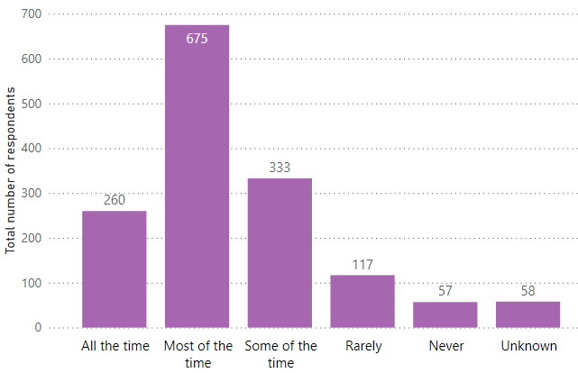
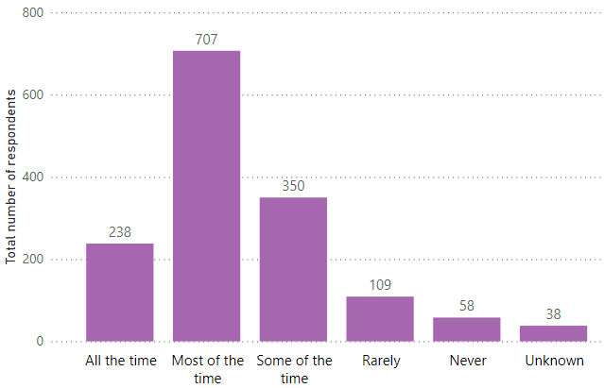
Theme 4: Survey Results
Do you feel comfortable in your local neighbourhood?
Do you feel safe in your local neighbourhood?
Many things can help us feel comfortable in our local neighbourhood – for example: places to stop and rest; shade and shelter; not too noisy; attractive and interesting things to see and do; being able to get to shops and services easily.
A large percentage of the respondents said that they felt safe and comfortable in their local neighbourhoods ‘most of the time’ but a significant also felt the same only ‘some of the time’.

Slide 42
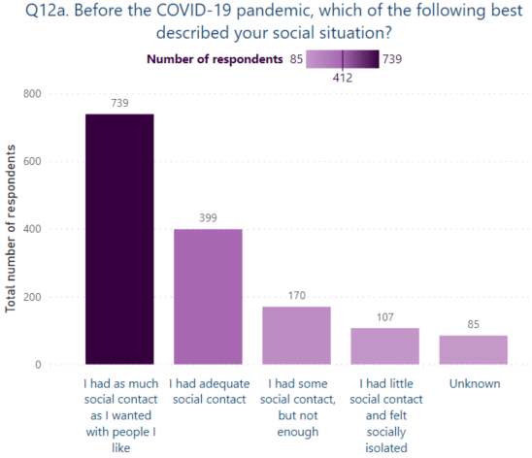
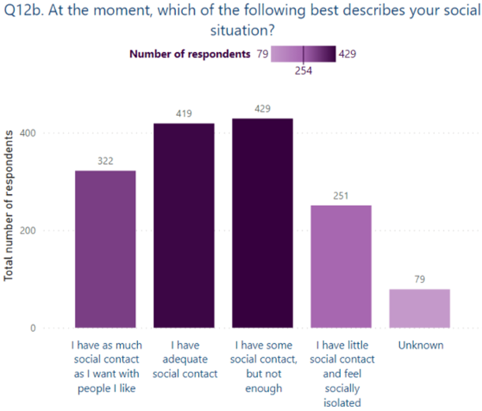
Theme 4: Survey Results
739 residents said that they had as much social contact as they wanted with people that they like followed by 399 saying they had adequate social contact.
419 residents said that they had adequate social contact whilst 429 said that they had some social contact but not enough.

Slide 43
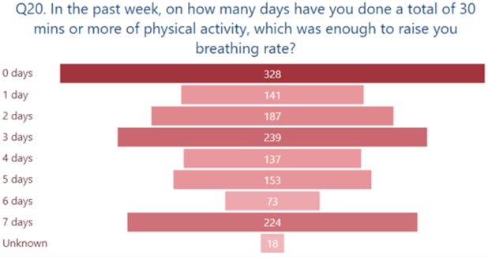
Theme 4: Survey Results
328 residents mentioned that they had 0 number of days with 30 mins or more of physical activity which was enough to raise their breathing rate.

Slide 44
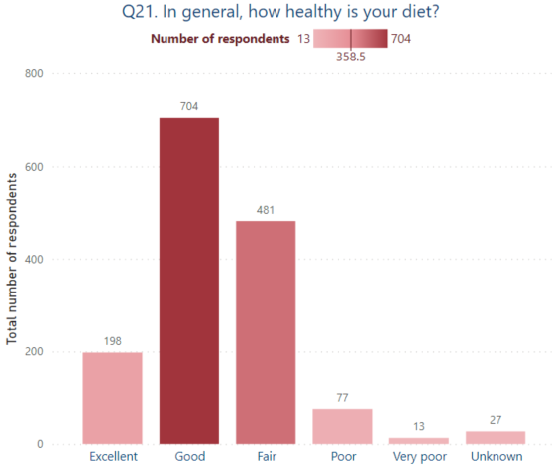
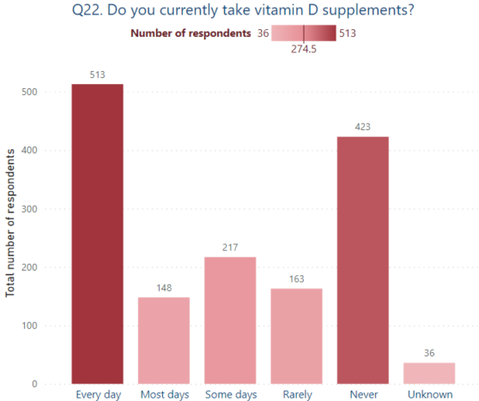
Theme 4: Survey Results
704 residents said that their diet was good with 481 mentioning it as fair.
513 residents said that they took their Vitamin D supplements everyday where as a significantly high number of 423 said that they never took it.

Slide 45
Voice of Residents - Survey
‘Encourage things like walking groups, which go at a gentler pace than ramblers and more accessible activities aimed at the 50+ generation at the leisure centres. Start early by encouraging younger people to think ahead.’
‘Encourage and facilitate more opportunities to meet people socially. Many older people find it harder to make new friends, where should we go? Pubs aren't ideal for everyone (even pre-covid), and clubs are generally for much younger people. A space where we can just drop in and meet people socially, where the focus isn't on the younger cohort and is open for more than a couple of hours a week, would be welcome.’
‘Several people have mentioned the need for more seating areas as they frequently need to rest when walking and the removal of a lot of these during lockdown have made it harder for them to independently move around and run errands. The same goes for easily accessible and clean public toilets.’
‘A better high street where I can shop for healthy food. Right now, we have a Tesco Metro. Create spaces where people can meet up (and I do not mean the library), encourage entrepreneurs to open up cafes in Manor Park. A thriving high street, green spaces and better air would make me very happy and might just prolong my life.’
The pavements are uneven so it is not particularly safe to walk unaccompanied if you have any mobility problems.’
‘There is nothing in Newham for older people like me. I used to go to a hobby class that had members from all parts of the community and we all loved being together but it was cancelled in favour of other classes that was only for certain members of the community. It really seemed that our inclusive class wasn't deemed to be as important.’
‘More visibility of community support officers as well as educating the older people with regards to dangers in the community. This should be provided in various languages so that people who speak other languages can understand what is being said.’
‘I suspect isolation is the most worrying thing, and people "falling through the cracks" can be lost. How can the council encourage people to watch out for their neighbours?’
‘Even during the day it can feel tense/unsafe being in public spaces, due to antisocial behaviour and this is worse even in the early evening (especially at transport hubs), so heaven knows what it is like late at night.’
‘Organised activities such as walks to encourage you to get out and about as walking alone is hard to motivate yourself to do.’
‘I see very little provision that reflects modern ageing. Most of what I've seen reinforces the stereotype that older people are exclusively interested in their past, their family and their culture. There seems little provision for later life learning, multicultural experience and new opportunities.’

Slide 46
Voice of Residents: Workshops and Consultations
Can the council limit the number of licenses and permits given to fast food retailers? There is too many junk food shops around.
Somewhere older people can buy fresh fruits and vegetables at discounted prices.
Healthy living should also include wider pavements along with access to green spaces with good air quality.
More neighbourhood policing people.
Considering the diversity of Newham perhaps arranging a global village/exchange display to help the community also connect with one another.
More blue badge parking.
Adding the volunteering sector to the second point and it would also help the social prescribers.
I find travelling/walking around Newham (especially on A13) more and more dangerous. Many cars drive much faster than the speed limit and overtake like if they were in a James Bond movie. Where are the police/road traffic officers?
Would it be possible to also review / assess opportunities to re-vamp Stratford Shopping Centre and surrounding areas to upgrade improve environment for older people too.

Slide 47
Priority 5: Planning and Preparing for Later Life

Slide 48
Summary
In terms of planning for later life, some residents said they have invested in property, have life insurance or have already paid for their funeral. However, it was notable how many residents said they had not made plans related to growing older or end of life. Some indicated this was a conscious choice: ‘I find it too depressing to think about at length’; ‘I live day by day’. Others suggested it had not crossed their minds. Making plans is a way of retaining independence, supporting health and wellbeing, and having wishes taken into account in later life. Through the Strategy, we will support residents to prepare and plan for later life.
Residents who commented on Health and Social Care services tended to have first hand experience - these residents offered suggestions for how the services they had used could be improved. In addition to resident feedback, many of the actions in this section have been informed by Public Health data and engagement with Health and Social Care stakeholders to drive improvements in specific areas, including across the NHS Ageing Well priorities.

Slide 49
Survey Results
Which, if any, have you done to prepare for getting older?
 | Number | %
Paid into a pension | 808 | 54%
Set aside money | 332 | 20%
Preparing financially for care and support | 122 | 8%
Looked into how to stay independent | 274 | 18%
Looked into how cared for will be looked after | 83 | 6%
Have a will | 529 | 35%
Legal Power of Attorney: Health and Care | 167 | 11%
Legal Power of Attorney: Finance and Property | 168 | 11%
Notes:
Wording of questions:
Do you care for someone who needs help because of illness, frailty, disability, a mental health problem or an addiction; and cannot cope without this support?
Does your caring role limit your activities in any way?

Slide 50
Voice of Residents - Survey
Due to the pandemic all GP appointments or contact was online. I am not very good with computers so it meant that I had to wait for others to help me just to make an appointment. I asked for help ... I can only say that one receptionist had the patience to explain things properly … I do think all staff should be properly trained to deal with elderly people
I have not been routinely monitored by my surgery (cholesterol, cardiac, ageing etc), except for when the Government needs to roll out something specific and provide funding
My GP is overcrowded and takes ages to get an appointment. Need solutions to have better availability.
We have to book health appointments online … and this is difficult for older people who did not grow up using computers and technology. The online services for the borough are confusing and haven’t been designed with the users in mind
‘Planned activities for older residents … so those of us approaching retirement can start to get a taste of what’s on offer, meet people of the same age and have healthy activities to participate in outside of work.’
It's very difficult to get a GP consultation, even by phone. It makes it very difficult to maintain or change prescription medication or get a review. I often just try to muddle through, often in pain, discomfort, or both. I am particularly fed up of being offered cervical screening that I do not need. Diabetes screening would be much more helpful.
The support for people with dementia and their carers needs to be improved. No support for carers who have elderly relatives who find taking medication difficult.
We have an 85-year-old neighbour who is very much struggling to cope. Following stays in hospital, he got support from the hospital discharge team; however, that stopped abruptly when they presumably should have handed over to the local social care team. Being not online, he is struggling to access anything.
Provide opportunities for older people to engage in activities together, provide things like dementia cafes

Slide 51
Voice of Residents: Workshops and Consultations
Everybody should be encouraged to have a plan for their own funeral in a nice way. They can then save up for it rather than it suddenly happening making a problem for the people left behind.
Developing a support network especially for people who are not just frail and isolated but also for the ones who have a terminal illness.
In the early 80’s (when I trained as a nurse!), there were Geriatric Health Visitors who made a huge contribution to the prevention elements of elderly care. Their training was very similar to HVs who worked with children, but obviously their clinical work was focused on maintaining quality of life and independence for elderly patients
How far is legal aid available for help with devising one’s will.
A to Z service directory for all residents, Newham specific with contact details.
Family mediation services, it is not just the person that is getting older, it is the family that is getting affected by it as well.
In order to have dementia friendly environment, people need to be educated about it and how people can help the person with dementia and their carer.
That is an excellent idea! I suffer from chronic sciatica and would welcome the courses to help manage the pain
Early [Dementia] diagnosis is essential and knowledge about symptoms is important;
we want to be supported to continue to do the things that are important to us to enable us to stay living at home as long as possible.
My Newham service – help residents plan for retirement. Could be an annual event with partners like insurance organisations.
Social prescribers are required.
Can we add a ‘bereavement support’ group/table/bench…
I am of the opinion, each individual diagnosed with dementia", will present with being at a different stage of the disease. Hence, not all diagnosed individuals will have the ability to be digitally confident; as such wouldn't it be essential to plan around the individual's confidence/competence ability or not?

Slide 52
Characteristics of Survey Participants

Slide 53
Respondents: Age and Gender
The highest number of respondents fell between the categories of 50-59 and 60-69 with 739 females, 718 males, 5 non-binary and 11 who prefer to self-describe.

Slide 54
Respondents: Ethnicity
The highest number of respondents were from White ethnic backgrounds, followed by Asian and Black ethnic backgrounds.

Slide 55
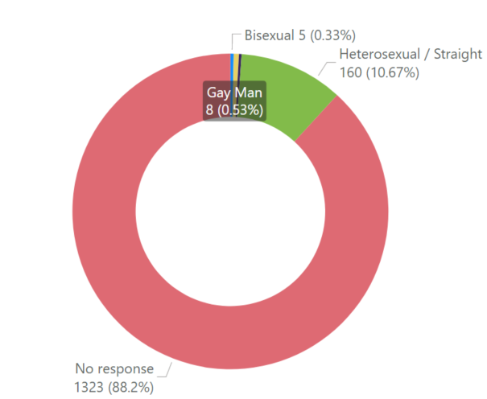
Respondents: Sexuality
Do you identify as:
 | Number | %
Heterosexual / Straight | 160 | 11%
Bisexual | 5 | <0.5%
Gay Woman / Lesbian | 4 | <0.5%
Gay Man | 8 | 0.5%
Prefer to Self-Describe | 0 | 0%
Prefer Not to Say / No Response | 1323 | 88%
Total | 1500 | 100%
Following resident feedback about the survey questions, a question on sexuality was added to the survey during the data collection. This meant not all respondents had the opportunity to answer this question. Future Ageing Well surveys will collect data on all protected characteristics.
Notes:
Wording of questions:
Do you care for someone who needs help because of illness, frailty, disability, a mental health problem or an addiction; and cannot cope without this support?
Does your caring role limit your activities in any way?

Slide 56
Respondents: Disability
Do you have a long- standing illness or disability?
 | Number | %
Yes | 848 | 57%
No | 652 | 43%
Total | 1500 | 100%
848 (57%) of the respondents had a long-standing illness or disability. Of these, 469 said that their illness or disability limited their activities ‘all the time’, 161 that said that it did that ‘most of the time’ and 204 that said, ‘some of the time’.
Notes:
Wording of questions in the survey:
Do you have any long standing illness or disability?
Does this illness or disability limit your activities in any way?

Slide 57
Respondents: Carers
Do you care for someone who needs help because of illness, frailty, disability, a mental health problem or an addiction?
 | Number | %
Yes | 332 | 22%
No | 1073 | 72%
Unknown | 95 | 6%
Total | 1500 | 100%
Around one in five respondents said they cared for someone. Of these, the majority said their caring role limits their activities ‘some’, ‘most’ or ‘all of the time’.
For more information about support available to Carers, please visit - Newham Carers
Notes:
Wording of questions:
Do you care for someone who needs help because of illness, frailty, disability, a mental health problem or an addiction; and cannot cope without this support?
Does your caring role limit your activities in any way?

Slide 58
Get Involved
It’s never too late to get involved. The Council would be delighted to hear from you, whether you live, work, volunteer or study in Newham.
To find out more about the Strategy or how you can take part, get in touch on: (email tbc) or (phone tbc) (9am - 5pm Monday to Friday).

