Slide 1
Market Position Statement ROUGH SLEEPING May 2024

Slide 2
Overview
What is considered rough sleeping?
Rough sleeping - is the most visible form of homelessness. It is typically associated with sleeping outside, but also refers to sleeping in a place not designed for living such as an empty building or a car. Some people are at a higher risk of rough sleeping than others.
Combined Homelessness and Information Network (CHAIN). Services that record information on CHAIN include outreach teams, accommodation projects, day centres and specialist projects such as the GLA-commissioned No Second Night Out.
CHAIN verified people are counted as having been seen sleeping rough if they have been encountered by a commissioned outreach worker bedded down on the street, or in other open spaces or locations not designed for habitation, such as doorways, stairwells, parks or derelict buildings.

Slide 3
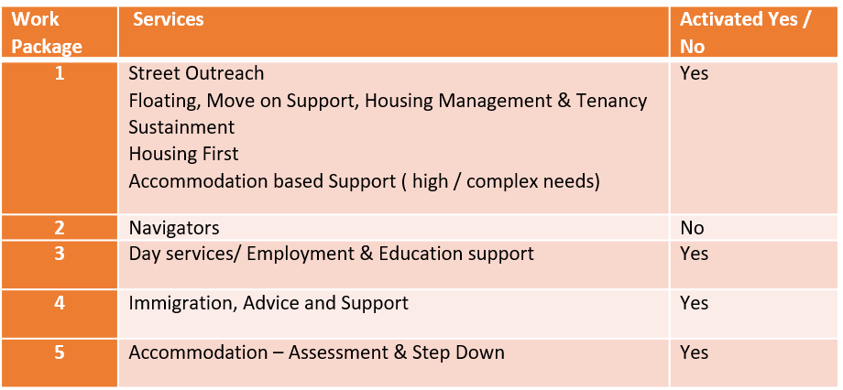
Overview
A commissioned Integrated Rough Sleeping Service (IRSS) commenced 1st September 2021, led by a contracted lead provider with sub-contracted providers delivering the key elements and work packages, detailed in table below.
The work packages can be flexibly “called off” in response to the changing strategic and financial landscape.
IRSS is partially funded by the Rough Sleeping Initiative (RSI) allocation for 2022/25, through GLA funding for delivery of Homefirst workers and through the ICB for hospital stepdown.

Slide 4
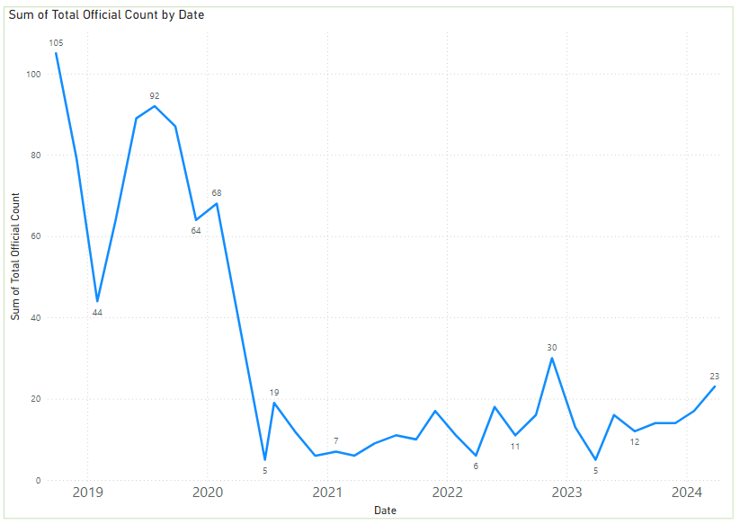
Demand
There are currently 42 people rough sleeping on the Newham streets of which, 2 are female.
11 females and 51 men are accommodated across the wider rough sleeper pathway. Of these, 10% have a diagnosed mental health condition that could be considered ‘severe’.
78% of the rough sleepers currently being supported by the Council have now registered with a GP
84% of rough sleepers who have been supported to move on have not returned to the street

Slide 5
Commissioned Activity
Newham’s single night rough sleeper snapshot figure in September 2019 was 105. This has steadily decreased to date (with variables such as weather and access to work leading to spikes in date) to the most recent official count to 40.
Following Newham’s successful response to the ‘Everyone in’ directive resulting from the pandemic, the IRSS service was commissioned in 2021 following Cabinet approval to award to CGL.
Currently there are 62 people accommodated in emergency accommodation through the LBN Rough Sleeping pathway
7 of the current cohort have no recourse to public funds, meaning the Council fund the full cost of their accommodation. We work closely with commissioned services, more specifically, our immigration advice service to progress claims in seeking status for these individuals to provide access to funding through benefit to enable a stable move on. Since the service began, we have transitioned 108 of this cohort into stable tenancy.
Since 2021, 862 individuals have moved through the pathway. 68% have transitioned into long term accommodation, with the remaining 32% either abandoning/being evicted from their accommodation (24%), leaving their accommodation of their own accord (5%) or going to prison (3%).
Of those rough sleeping 9 have recourse which is an early indications that the cost of living is impacting on new Rough sleepers.

Slide 6
Equity / Protected Characteristics
Newham are seeing an uncharacteristic growth in the number of asylum seeing men under 35 accessing services through Welcome Newham.
Of those accommodated in the pathway, 13 are men and 62 are female.
A small proportion of those in the pathway occupy the over 55 bracket (15%).
38% are UK citizens, with the remaining 62% either settled, pre-settled refugee or indefinite leave to remain.
38% identify as either British or English, with 11% Romanian, 9% Lithuanian and 5% Indian making up the next level of demography. The remaining in the pathway are from mixed backgrounds, with only 1% recognised as stateless.

Slide 7
Commissioning Priority 1: Extend the IRSS
The Council is in the process of reviewing the first three years (of 5) delivery of its integrated rough sleeping service. This will outline the rationale for extending the service and provide an overview of its performance, issues and mitigations.

Slide 8
Commissioning Priority 2: Continue to reduce numbers on the street
We have seen recent increases to the street population figure – there are multiple variables that can influence the inclination/declination of this figure throughout the year, most notably, the weather. We performed well during 23/24 in a relatively forgiving SWEP period, but are aware that RSI funding has reduced in 24/25. We plan on achieving this by strengthening our accommodation offer through onboarding of additional HMO style accommodation, subject to planning exemption.

Slide 9
Commissioning Priority 3: Promote efficiency in the pathway
We currently operate an assessment centre as part of our offer. We have feedback from providers that we are experiencing higher acuity in this setting – making it difficult to provide move on into stepdown. We are working to strengthen the pathway by adding accommodation, but this has been a challenge due to local planning. In the short term – we continue to create capacity in the pathway by moving service users that are at the end of their support journey onto stable accommodation.

Slide 10
Commissioning Priority 4: Focus on prevention
We will be launching mini competitions for category 2 of the Supporting Vulnerable Adults DPV during 24/25 – this will enable us to call off services to meet the needs of the single vulnerable homeless population to reduce the impact of spend in temporary accommodation and provide meaningful long term outcomes for the cohort.

Slide 11
Commissioning Priority 5: Focus on prevention
We are currently in process to launch a standalone tender to deliver support for those owed a relief duty under the Housing Act (1996). This will further enable us to alleviate cost pressure in temporary accommodation and the building will provider wider benefits for the rough sleeping cohort to access advice and workshop style activity.

Slide 12
Commissioning Priority 6: Deliver upon year 3 of HRSS
The year 2 highlight report analysing performance against objectives set in the HRSS action plan has been completed and actions for year 3 have been identified. We will continue to track these actions via a specific HRSS steering group.

Slide 13
Rough Sleeping – Mid-Year Update
Commissioning Priority 1: Extend the Integrated Rough Sleeping Service contract
The one year permissible extension to the rough sleeping service has now been carried out and agreed by senior leaders. There is a further one year extension remaining with a contract expiry set for August 31st 2026 if enacted. Planning for the recommissioning of the service is to begin in the new year, including consultation/engagement with the market.
Commissioning Priority 2: Continue to reduce numbers on the street
Commissioners working in conjunction with the street population manager have worked hard to maintain oversight of street population and work to reduce numbers on the streets via collaborative and partnership working with commissioned services and internal partners such as enforcement and cleansing. When comparing to the same time last year – there is snapshot increase of an additional 1 person on the street. Numbers over the last 6 months have increased slightly due to NASS cohort leaving accommodation due to changes in notice period in asylum hotels and a requirement to have a greater capacity in our off the streets accommodation. The LBN Street Population Manager and wider commissioning team have also worked with our commissioned provider of street outreach to mobilise a Winter ‘pop up’ hub which also acts as part of our SWEP response. This is the second year LBN have mobilised such a service following receipt of additional funding from the Ministry of Housing, Communities and Local Government (MHCLG).
Commissioning Priority 3: Promote efficiency in the pathway and improving outcomes for residents
Commissioners have liaised with commissioned service to drive throughput in the pathway – including an onsite visit to the off the streets assessment centre. Throughput has improved in this area following the visit but move on is limited in the low support needs domain over quarters one and two. The commissioning team are also working on implementing a dashboard to provider greater oversight of efficiencies in the pathway and information relating the individual service users journey of change/achievement of goals.
Commissioning Priority 4: Focus on prevention
Commissioners in conjunction with the street population manager have worked hard to prevent instances of rough sleeping, including preventing evictions in services and via mobilisation of MDT meetings to address issues at a granular level.
Commissioning Priority 5: Deliver upon year 3 of the HRSS
The delivery of actions under the HRSS is changing to be absorbed into the Homelessness Response Programme. Actions are currently in the process of being transferred.

