Slide 1
AUTISTIC RESIDENT ADVISORY GROUP (ARAG)
Monday 8 July 2024
Co-Chair: Serena Elstub, ASDB Resident Representative Linda Wan, Autism Lead - Commissioner

Slide 2
AGENDA
1 | Welcome & Introductions Meeting Changes Meeting Rules & Review | Serena Elstub, Council Co-Chair | 10.00-10.10 | 10min
2 | Guest Speakers Hospital People Participation Team | Mbemba Bojang & Anna Sandiford
3 | Minutes & Matters Arising (30 April 2024) | Serena Elstub, Council Co-Chair | 11.00-11.05 | 5min
4 | Autism Strategy Delivery Board (ASDB) - Updates (21 May 2024) | Serena Elstub, Council Co-Chair | 11.05-11.10 | 5min
5 | ARAG Member appointments ARAG Co-Chair Prority Leads Action Leads | Linda Wan, Council Co-Chair | 11.10-11.15 | 5min
6 | Autism Strategy Action Plan Governance structure Role of ARAG members Review of Co-produced actions | Linda Wan, Council Co-Chair | 11.15-11.45 | 30min

Slide 3
AGENDA
7 | ARAG updates Whats App Broadcast Venue days & times review 2025 List of support resources for autistic residents | Linda Wan, Council Co-Chair | 11.45-11.55 | 10min
8 | AOB | Linda Wan, Council Co-Chair | 11.55-12.00 | 5min
9 | Meeting Rules Review | Serena Elstub, Council Co-Chair | 12.00-12.05 | 5min
10 | Next Meeting 8 October 2024 @ Canning Town Library | Serena Elstub, Council Co-Chair

Slide 4
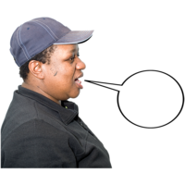
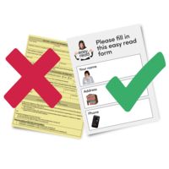
Meeting Rules Linda Wan
Please speak slowly with easy words
No jargon to be used
Stop if people show they don’t understand
Use you communication cards if you want to speak

Slide 5
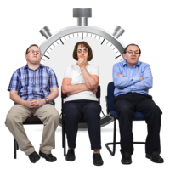
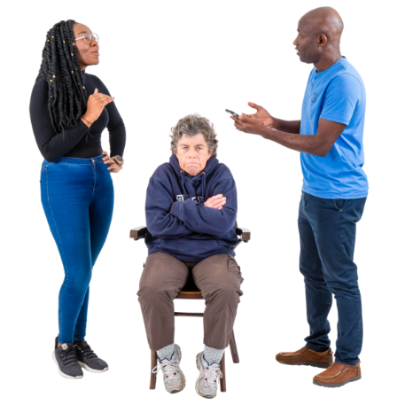
Meeting Rules Linda Wan
please give us a chance to ask questions
make sure everyone has time to understand what is Being said
Don`t speak over each other

Slide 6
NHS People Participation Team
Monday 8 July 2024
Mbemba Bojang & Anne Sandiford
A workshop: designing an autism themed world café

Slide 7
What is World Café Workshop?
A World Café is a great solution for tapping into the collective wisdom and creativity of a group.
The methodology is a simple, effective, and flexible format for hosting large group dialogue. Each element of the method has a specific purpose and corresponds to the World Café’s theme.
A world café usually consists of three rounds (or tables), each between 15-20 minutes long. Participants gather in small groups and each group explores the same question for each round. After a round is complete, one person remains at the table as a facilitator / host while the others travel to new tables and conversations – spreading the insights from previous discussions.
The idea behind this is to create a space that supports 'good conversation', where anybody can talk about things that matter to them.

Slide 9
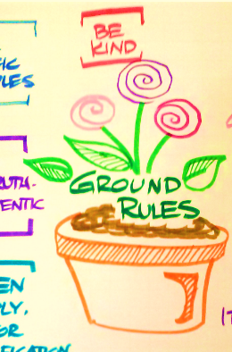
Ground rules
Be kind
Be the crew, not the passenger
Value diverse perspectives
Remember it is not personal
Be non judgemental
Be respectful to others
Assume Good intent
One speaker at a time
Come prepared

Slide 10
World cafe
The flow of the workshop
The table host will open the discussion
5 participants per table
Welcoming of participants and Introduction
After each round participants move as a group to another table
Discussions
Harvesting
(Group feedback)
Talking spoon
After the 3rd round each table reports back to the whole group
Three rounds and one question per round

Slide 11
World café method 3 rounds of conversations
1 host per table staying to facilitate the discussions
(the host will be supported by a staff)
1 question per round
Participants writing, drawing and doodling key ideas
4 to 5 travellers changing table after each round

Slide 12
Time allocation
The duration of the workshop will be two hours
15 minutes for introduction (café opening)
10 minutes for icebreaker
Harvesting (group feedback) 20 minutes
20 minutes per round
Evaluation of the Workshop 5 minutes
10 minutes tolerance for moving around from one table to the another

Slide 13
Questions
Round 1:
What is important to you about the theme of “Listening and responding to people who are worried or distressed”, and why do you care?
This question intends to focus the collective attention of the participants
Round 2:
What is missing from the picture so far? ? What are we as participants not seeing & where do we need more clarity?
This question intends to connect Ideas for Deeper Insight
Round 3:
What seeds/ideas might we plant together today that could make the most difference to the future of compassionate communication in Newham Hospital?
This question intends to Create Forward Momentum and change ideas for effective and compassionate Communication.

Slide 14
The role of the Host (the main Facilitator)
Timekeeper
explains the purpose of the event and how the information will be used
welcomes the participants
Gives an introduction to the World Café process

Slide 15
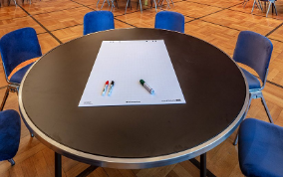
Role of table facilitators
Gently & as appropriate, encourage people at your table to jot down key connections, ideas, discoveries, and deeper questions as they emerge.
Remain at the table when others leave
Welcome travellers from other tables for the next round of conversation
Briefly share key insights from the prior conversation so others can link and build using ideas from their respective tables.

Slide 16
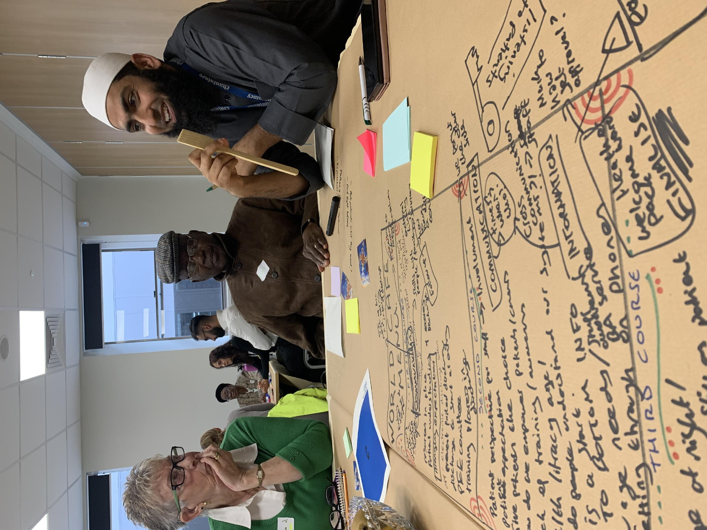
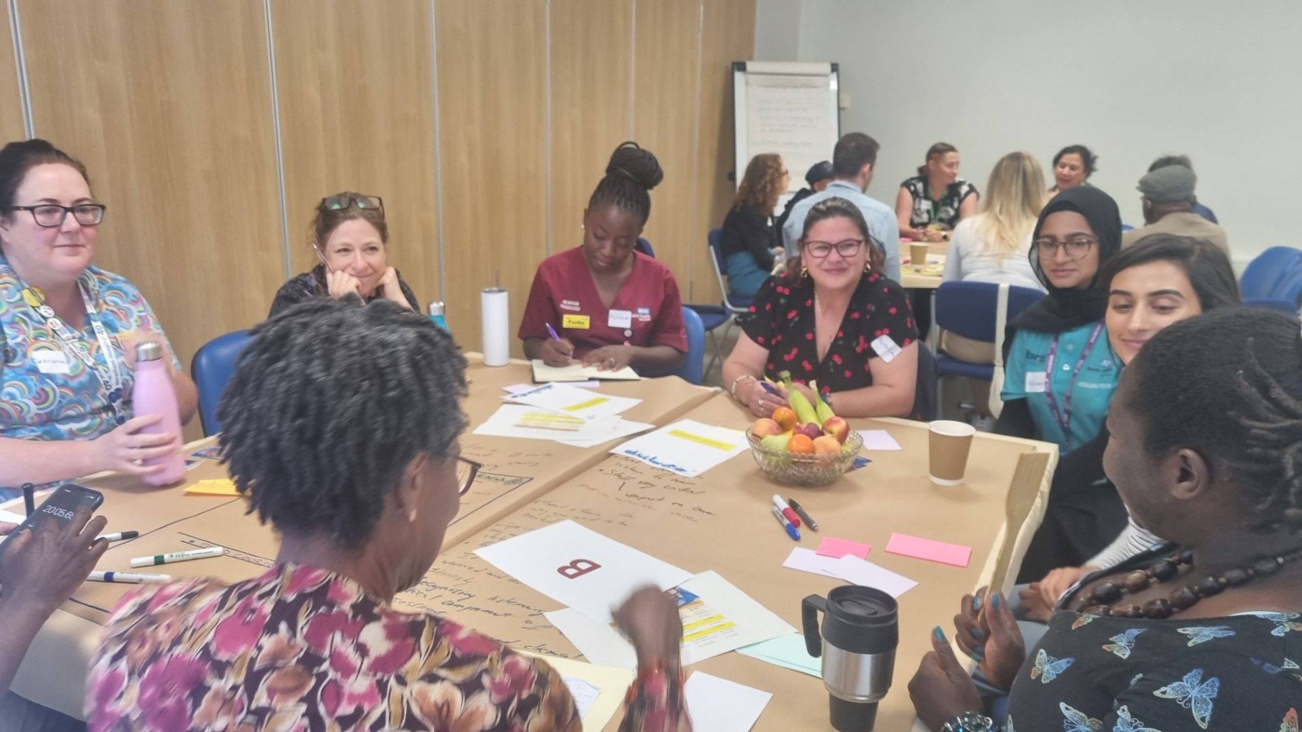
NHS, Hospital People Participation Team Mbemba Bojang & Anna Sandiford
World Café as a forum for brainstorming and idea generation.
Looking for a mix of 10 autistic residents and carers
Wednesday 25 September 9-12pm at the Hospital
Autism Themed discussion

Slide 17
NHS, Hospital People Participation Team Mbemba Bojang & Anna Sandiford
What is your experience of the hospital?
What do you think needs to be addressed at the hospital for autistic people?
Who would you like to have seated around the table for discussion?
What's important to you?
What do you want to talk about?

Slide 18
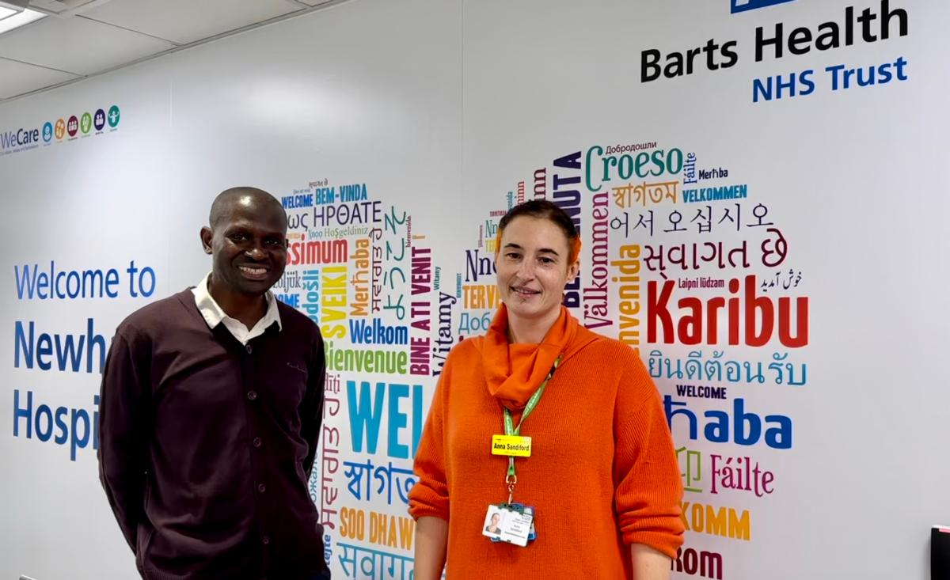
NHS, Hospital People Participation Team Mbemba Bojang & Anna Sandiford
Get in touch Mbemba Bojang: People Participation Lead 07861759139 mbemba.bojang@nhs.net Anna Sandiford: People Participation Lead 07751 675 963 anna.sandiford@nhs.net

Slide 19
NHS, Hospital People Participation Team Mbemba Bojang & Anna Sandiford

Slide 20
Minutes & Matters Arising
ARAG

Slide 21
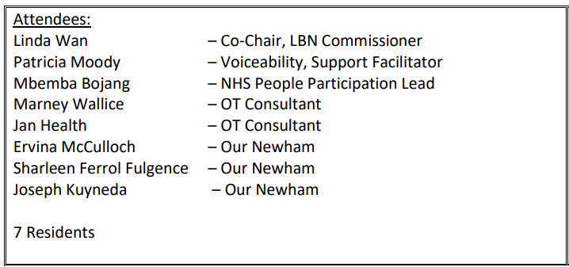
Minutes & Matters Arising Linda Wan
Autism Residents’ Advisory Group (ARAG) Meeting
Canning Town Library 30.04.2024 10:00am – 11:30am

Slide 22
Minutes & Matters Arising Linda Wan
Autism Residents’ Advisory Group (ARAG) Meeting
Canning Town Library 30.04.2024 10:00am – 11:30am
Guest Speakers
Mbemba Bojang, NHS People Participation Lead
works with Newham patients to help shape hospitals, ensure engagement and participation with a focus on quality improvement to make hospitals better
Sharleen Ferrol Fulgence, Ervina McCulloch & Joseph Kunyeda Our Newham
Our Newham Money, Work, Rights, all working towards making Newham Financially healthy
Marney Wallice & Jan Healey, Housing Design
Housing planning policy around locations and design

Slide 23
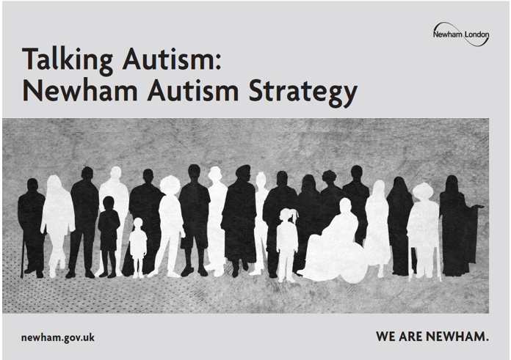
Minutes & Matters Arising Linda Wan
Autism Residents’ Advisory Group (ARAG) Meeting
Canning Town Library 30.04.2024 10:00am – 11:30am
Autism Strategy

Slide 24
Minutes & Matters Arising Linda Wan

Slide 25
Autism Strategy Delivery Board Update
ASDB
Serena Elstub

Slide 26
Autism Strategy Delivery Board Serena Elstub

Slide 27
ARAG member appointments
Linda Wan

Slide 28
ARAG member appointments Linda Wan
ARAG Co-chair – new appointment
As part of my current job, I've had the chance to chair and moderate meetings, which has helped me improve my ability to guide conversations and make sure everyone is heard. These skills I believe will be very important for the role as Co-Chair, where one of my main duties is to make sure everyone feels welcome and that the talks go in a good direction. The skills I've learned from setting up and running meetings will also help me plan and run the ARAG sessions well.
I know how important it is to work together in this position, and I'm excited to work closely with the Council Co-Chair and the other members to make sure our meetings are useful and focused on what's best for our community. My commitment to this job is shown by the fact that I'm ready to spend the time needed for planning, meetings, and follow-up tasks.
I am excited about the opportunity to work alongside fellow residents and the Council to shape a more inclusive and supportive environment for autistic individuals in Newham.
Emma Kofie

Slide 29
ARAG member appointments Linda Wan
Priority Areas, Working Groups & Co-delivery
New way of working, shaping & developing & piloting
30+ member actions identified over 2 years
Reward & Recognition Payment £13.15/hour*
6x Priority Leads
Several Action Leads
Volunteers / ambassadors
*people on benefits can work up to 16hours / week without it impacting on their benefits

Slide 30
ARAG member appointments Linda Wan
Priority Areas, Working Groups & Co-delivery of actions
improve understanding and acceptance of autism within society;​
improve autistic children and young people’s access to education - and support positive transitions into adulthood;​​
support more autistic people into employment;​
tackle health and care inequalities for autistic people;​
build the right support in the community and support people in inpatient care; and​
improve support within the criminal and youth justice systems.

Slide 31
ARAG member appointments Linda Wan
6x Priority Leads
Attends working group & feeds back on progress made by action leads (1 hour)
Feeds back to ARAG on progress in the working group (5min)
Co-ordinates meetings with ARAG members delivering actions under this priority (1 hour/month)
Reports progress to ARAG & ASDB Co-chairs (1hour/month)
Delivers on actions identified in the strategy (task & time to be agreed with Autism Lead Commissioner)
Action Leads
Delivers on actions identified in the strategy (task & time to be agreed with Autism Lead Commissioner)
Attends meeting co-ordinated by Priority Lead and feeds back to this group on progress and receives help, support & guidance from this group to progress their action

Slide 32
ARAG member appointments Linda Wan
Priority Leads
Aurora Todisco
Jay Gee
Natalya Fisher
Shantell Thomas
2x more Priority Leads needed
Action Leads applications
More Action Leads needed
To apply:
See email ‘ARAG Roles explained’ (this will be resent to ARAG members again today)
Send your application to:
Email: Autism.Commissioning@newham.gov.uk
subject: ARAG Priority/Action Lead Roles

Slide 33
ARAG member appointments Linda Wan

Slide 34
Autism Strategy Action Plan
Linda Wan

Slide 35
Autism Strategy Action Plan Linda Wan
Governance structures (slide 31)
How will everything work with Action Leads, Priority Leads and Working Groups?
Who reports to who?
Will a diagram help?
Role of ARAG members
Monitoring progress of actions (unofficial role)
Request updates from working groups via Priority Leads
Receive progress reports from Autism Lead Commissioner
Open for discussion
Review of co-produced actions
Print out to share

Slide 36
Autism Strategy Action Plan Linda Wan

Slide 37
Sharing information

Slide 38
Sharing information Linda Wan
Whats app broadcast
Receive up to date autism related information as and when it comes through to the Council
Contact details and replies to administrator are kept private
Review of venues times & days of ARAG meetings
Survey link to review preferences
Developing a list of support resources
Print out to share

Slide 39
Sharing information Linda Wan

Slide 40
AOB

Slide 41
AOB Linda Wan
Oliver McGowan EbE Trainers (Experts by Experience)
Work with NHS staff
Get training to deliver to NHS staff
email autism.commissioning@newham.gov.uk
Subject title: OM EbE

Slide 42
AOB Linda Wan
Newham Libraries
Keyword search
autistic: https://libraries.newham.gov.uk/search?term=autistic&field=&facets=&listview=false&sort=PUBDATE_desc&limit=203&page=
Autism: https://libraries.newham.gov.uk/search?term=autism&field=&facets=&listview=false&sort=PUBDATE_desc&limit=203&page=

Slide 43
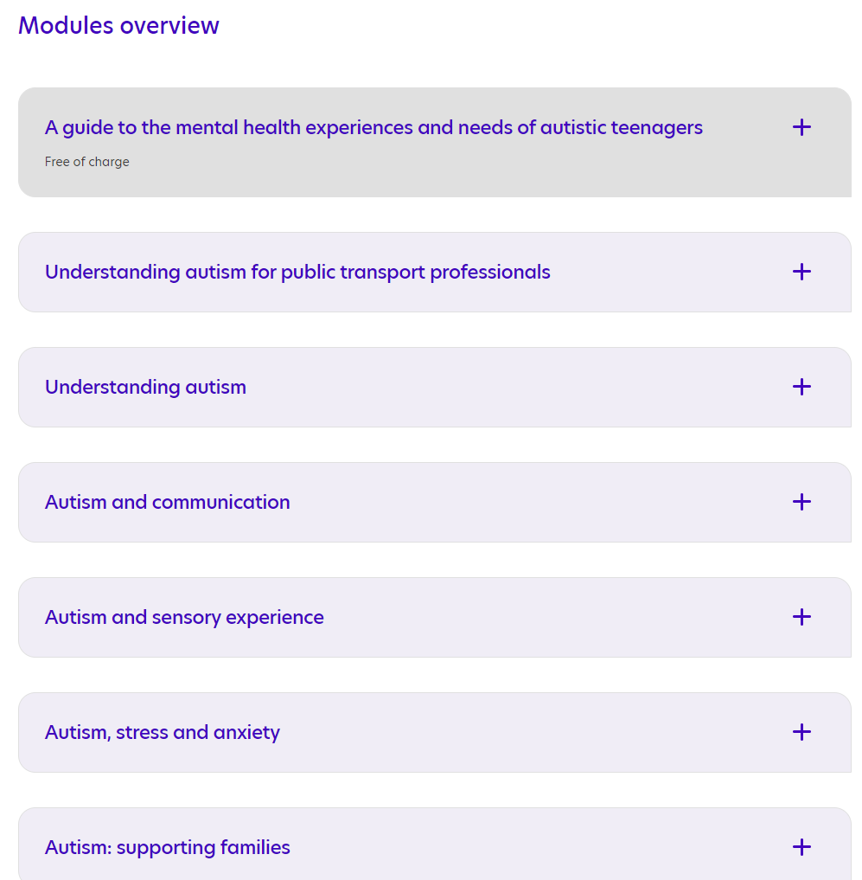
AOB Linda Wan
National Autistic Society e-learning modules
E-learning (autism.org.uk)

Slide 44
AOB Linda Wan
Autism Research – monthly roundup
Autism Research—What’s New in May — Neurodiverse Connection (ndconnection.co.uk)
Autistic people can communicate well with one another—further evidence?
Who decides the ‘right’ way to learn to speak?
Does masking mean better friendships and relationships?
Autonomy and Autistic people with learning disabilities
Morality and Autistic people
Negative views of autistic people in research journals?
OCD Versus Autism?
Stimming (repeated movement/sound): purposeless for who?

Slide 45
AOB Linda Wan
MH Elf Question Time 29 June 2024
You can watch the live stream again on the Mental Elf YouTube channel: https://elfi.sh/mhqt-autism
Read the live tweets sent by the Mental Elf: https://x.com/Mental_Elf/status/1798027854724399180
Read the two systematic reviews produced by the NIHR Mental Health Policy Research Unit
Approaches to improving mental health care for autistic children and young people https://doi.org/10.1017/S0033291724001089
Approaches to improving mental health care for autistic people: a systematic review https://www.medrxiv.org/content/10.1101/2023.03.10.23287101v1 (pre-publication)

Slide 46
AOB Linda Wan
Our Newham WORK
2x volunteer Ambassadors
Support with SEND internships – a wage will be paid
Ambassador to look at workplaces – reward and recognition paid
email ournewhamwork.engagementteam@newham.gov.uk
Subject title: Ambassador

Slide 47
AOB Linda Wan
Ageing Well Residents Advisory Group (aged 50+) The Ageing Well Resident Advisory Group (RAG) – Ageing Well in Newham – Newham Council
Ageing Well Festival
Saturday 5th October 2024, 10am to 4pm
Forest Gate Community School, Forest Lane, E7 9BB
Ageing Well Festival – Ageing Well in Newham – Newham Council

Slide 48
Meeting Rules Review

Slide 49
Meeting Rules Linda Wan
Please speak slowly with easy words
No jargon to be used
Stop if people show they don’t understand
Use you communication cards if you want to speak

Slide 50
Meeting Rules Linda Wan
please give us a chance to ask questions
make sure everyone has time to understand what is Being said
Don`t speak over each other

Slide 51
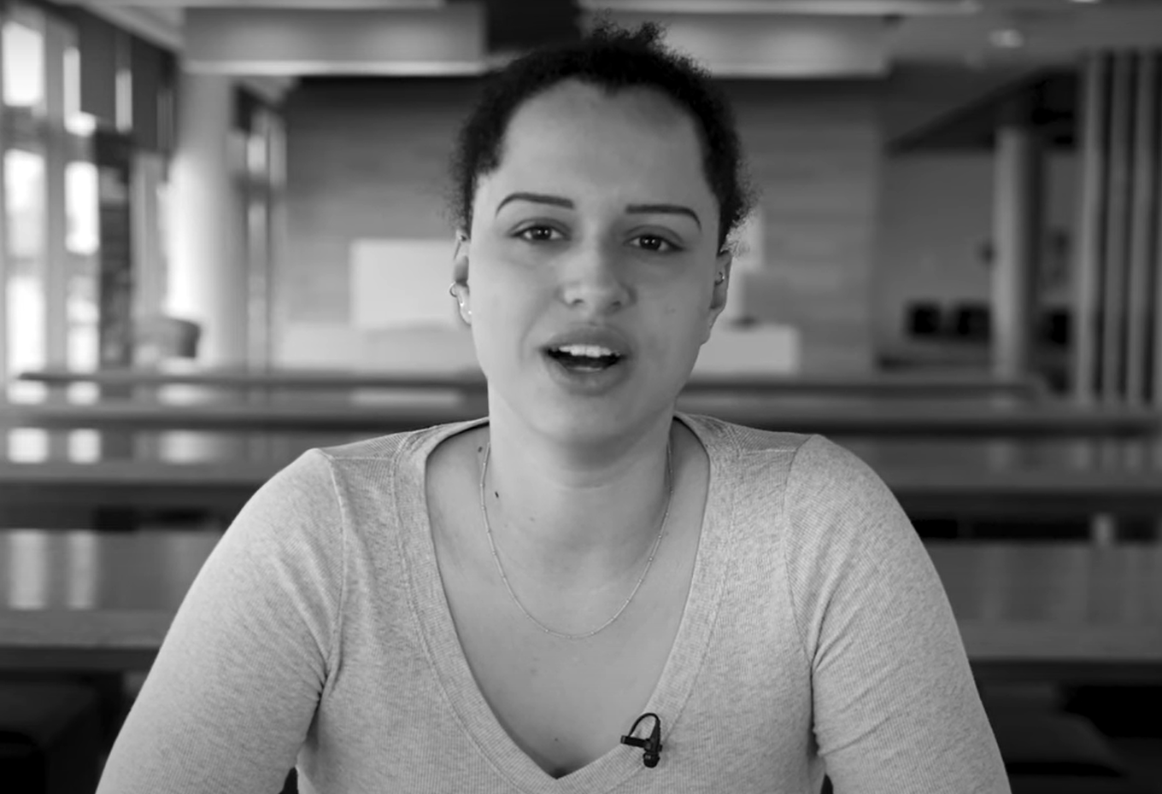
Thank You
ARAG Co-chair
July 2023 – July 2024
Focus group sessions
ASDB member
Autism Video Talking Autism - YouTube

Slide 52
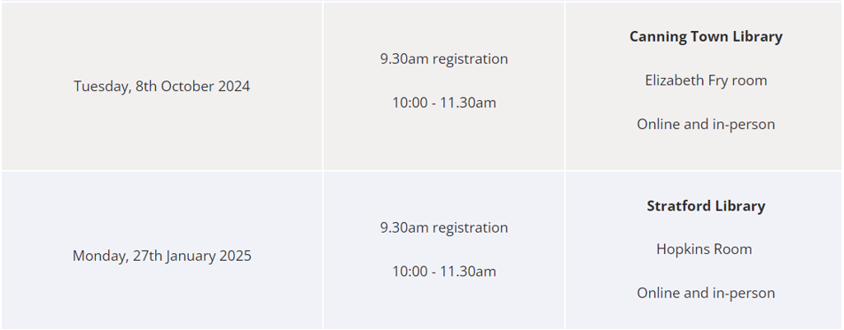
Dates of next meeting

Slide 53
THANK YOU

