Slide 1
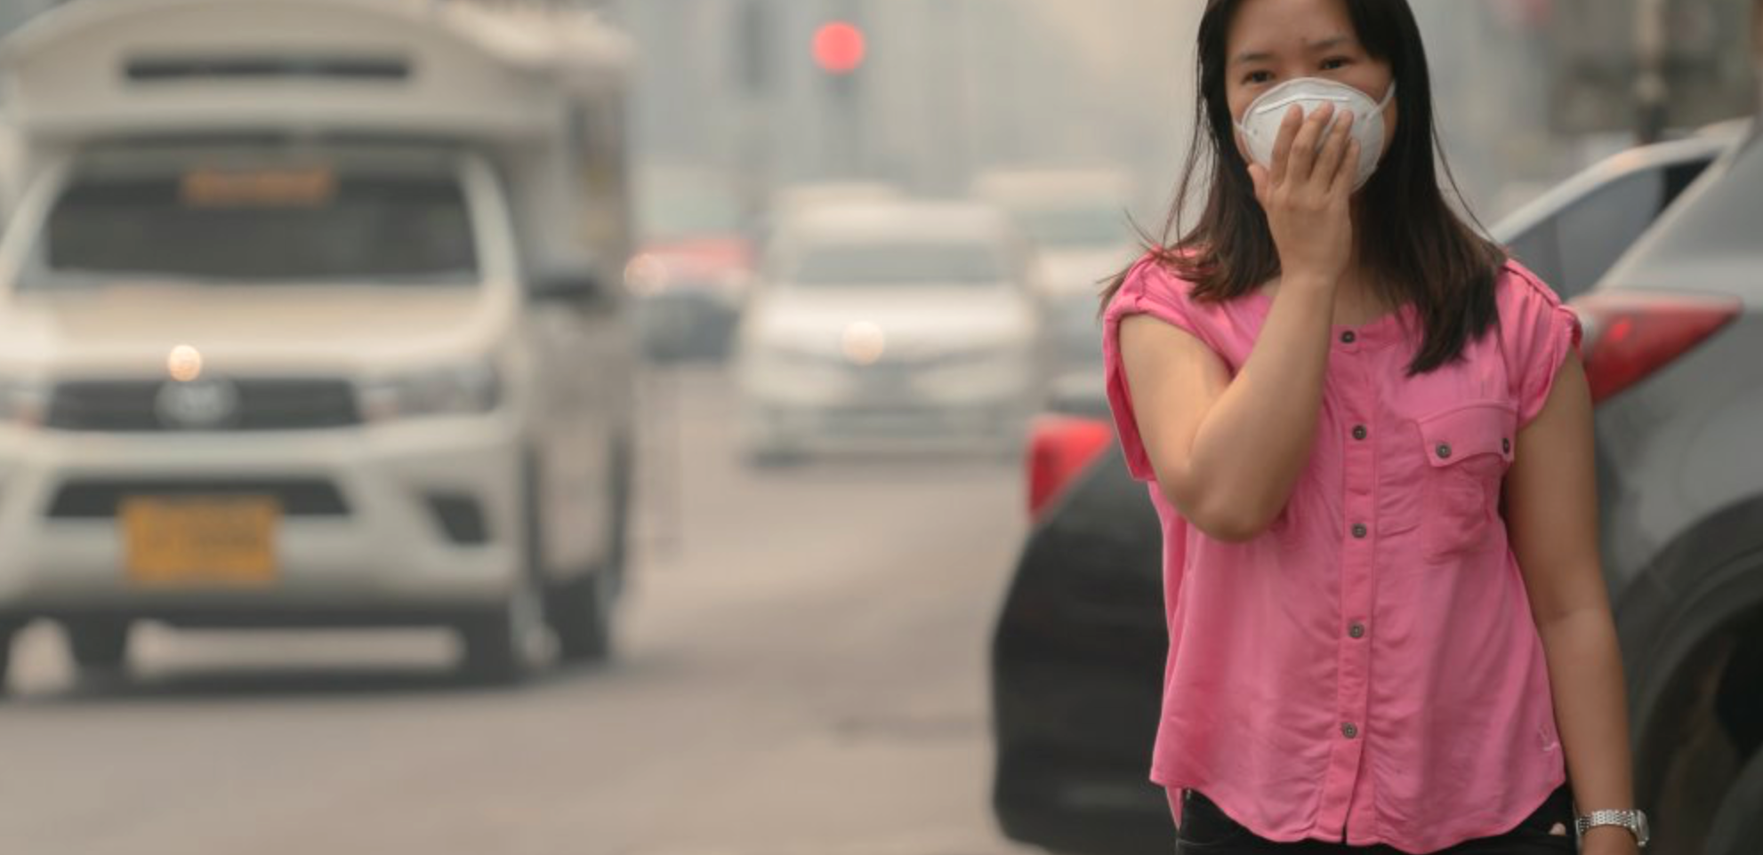
Air Pollution Workshop
Notes:
Hello everyone! Everybody take a big breath in. How does that feel?
We breathe all the time but can anyone tell me why we need to breathe?
What is the air made up of?
What are we breathing in? (Oxygen / CO2)
Does anyone know the names any other gases in the air? (nitrogen makes up most (80%) of the air we breathe. It is a neutral gas. It isn't good for us or bad for us)
What about pollution and some of the things we breathe in that might be bad for us?
Even short-term exposure to pollutants can further exacerbate acute health effects and increase mortality rates, hence taking action on air pollution is even more important now amidst unprecedented circumstances which have highlighted the fragility of respiratory health and the disproportionate impacts of Covid-19 and air pollution on Black, Asian and Minority Ethnic communities, and those living in Newham’s most deprived areas. It is more important than ever that we all take personal responsibility to cut air pollution however we can.

Slide 2
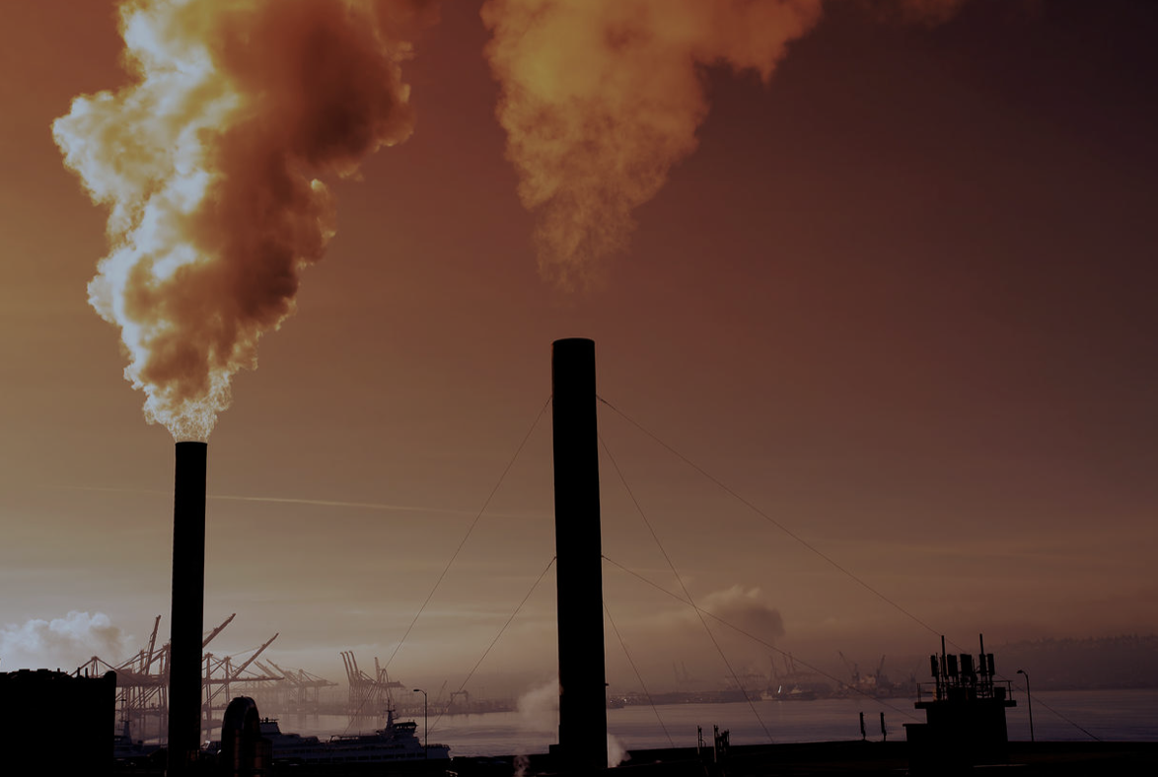
What is air pollution?
Air pollution refers to the release of pollutants into the air that are detrimental to human health and the planet as a whole.
Notes:
Air pollution is a mix of particles and gases that can reach harmful concentrations both outside and indoors. Its effects can range from higher disease risks to rising temperatures. Soot, smoke, mold, pollen, methane, and carbon dioxide are a just few examples of common pollutants. Outdoor air pollution originates from natural and anthropogenic sources. While natural sources contribute substantially to local air pollution in arid regions more prone to forest fires and dust storms, the contribution from human activities far exceeds natural sources.

Slide 3
Nitrogen Dioxide (NO2) and Particulate Matter (PM) are the two most prevalent types of air pollution!
NO2 (smog), or “ground-level ozone,” as it is more often called, occurs when emissions from combusting fossil fuels react with sunlight.
Soot, or “particulate matter,” is made up of tiny particles of chemicals, soil, smoke, dust, or allergens, in the form of gas or solids, that are carried in the air.
Notes:
Nitrogen dioxide, mainly emitted by power generation, industrial and traffic sources, is an important constituent of particulate matter and ozone. There is growing evidence that independently, it can increase symptoms of bronchitis and asthma, as well as lead to respiratory infections and reduced lung function and growth. Evidence also suggests that NO2 may be responsible for a large disease burden, with exposure linked to premature mortality and morbidity from cardiovascular and respiratory diseases.
Particulate matter (PM) are inhalable and respirable particles composed of sulphate, nitrates, ammonia, sodium chloride, black carbon, mineral dust and water. Sources of PM include combustion engines (both diesel and petrol), solid-fuel (coal, lignite, heavy oil and biomass) combustion for energy production in households and industry, as well as other industrial activities (building, mining, manufacture of cement, ceramic and bricks, and smelting).

Slide 4
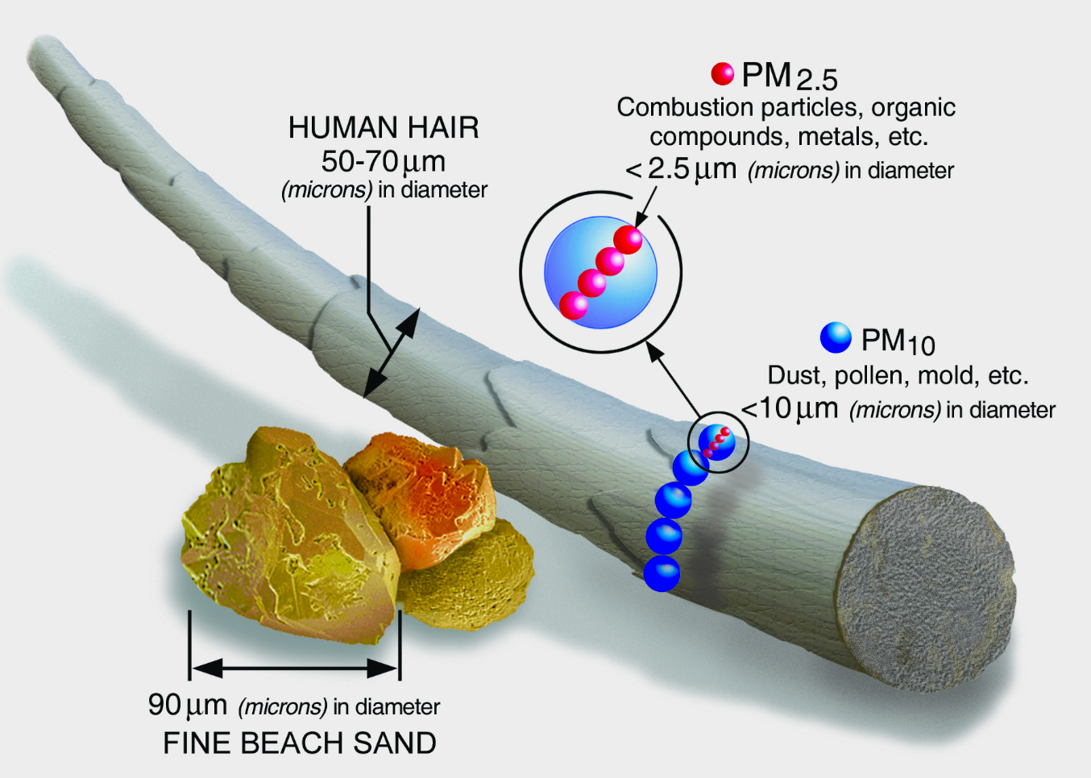
How big is Particulate Matter?
Notes:
PM10 : inhalable particles, with diameters that are generally 10 micrometres and smaller; and
PM2.5 : fine inhalable particles, with diameters that are generally 2.5 micrometres and smaller. How small is 2.5 micrometres? Think about a single hair from your head. The average human hair is about 70 micrometres in diameter – making it 30 times larger than the largest fine particle. The tiniest airborne particles (PM 2.5 and smaller) — are especially dangerous because they can penetrate the lungs and bloodstream and worsen bronchitis, lead to heart attacks, and even hasten death.

Slide 5
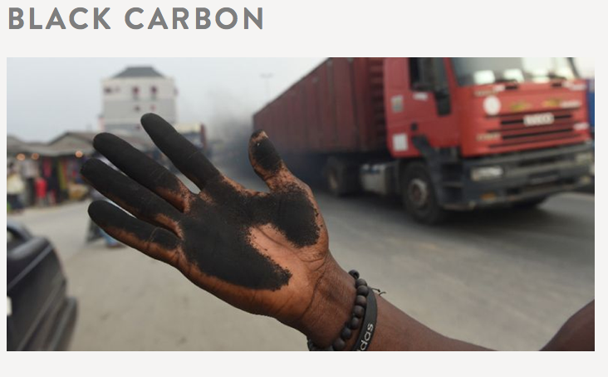
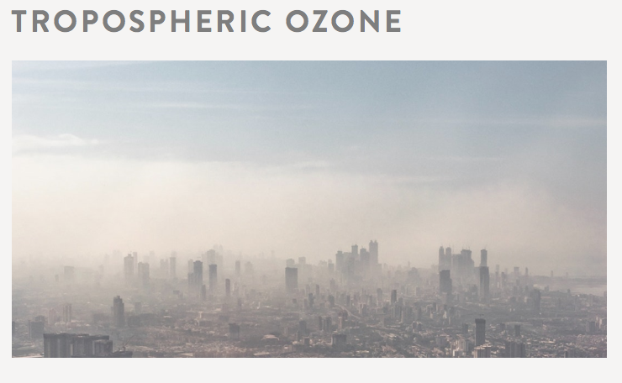
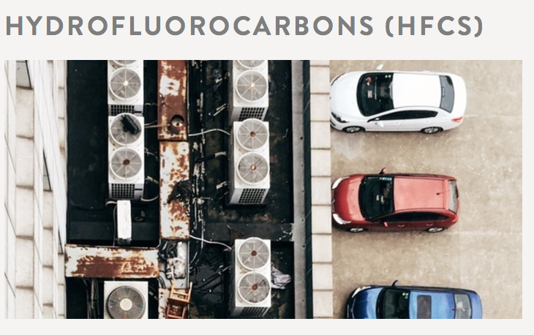
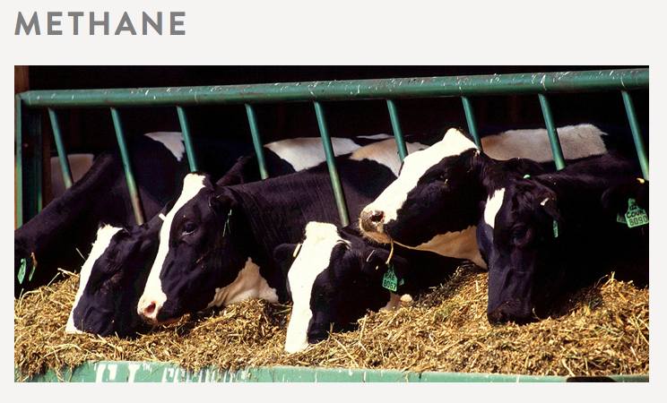
Short lived climate pollutants (SLCPs)
Notes:
Black carbon - is one of the largest contributors to global warming after carbon dioxide (CO2). It also known to decrease agricultural yields and accelerate glacier melting. Black carbon is formed by the incomplete combustion of fossil fuels, wood and other fuels. Complete combustion would turn all carbon in the fuel into carbon dioxide, but combustion is never complete and CO2, carbon monoxide, volatile organic compounds, and organic carbon and black carbon particles are all formed in the process.
Tropospheric ozone - is a major air pollutant and greenhouse gas formed by the interaction of sunlight with hydrocarbons and nitrogen oxides, which are emitted by vehicles, fossil fuel power plants, refineries, and other industries. It is especially harmful to vegetation and human health.
Hydrofluorocarbons - are man-made greenhouse gases used in air conditioning, refrigeration, solvents, fire extinguishing systems, and aerosols. Though HFCs represent a small fraction of current greenhouse gas emissions, their potential to warm the atmosphere is hundreds to thousands of times greater than that of the same given mass of carbon dioxide.
Methane - is emitted by human activities such as leakage from natural gas systems and livestock production, as well as by natural sources such as wetlands. It is a powerful greenhouse gas whose potential to warm the atmosphere is many times stronger than that of the same given mass of carbon dioxide

Slide 6
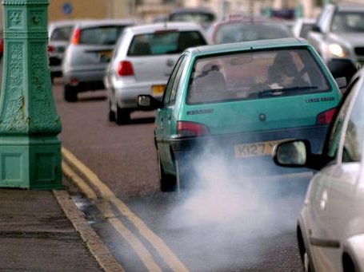
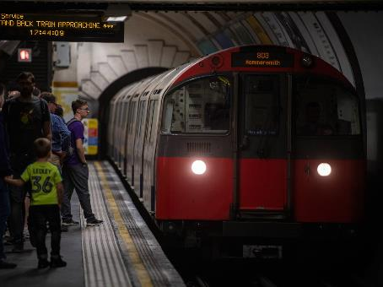
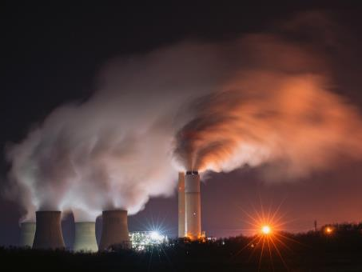
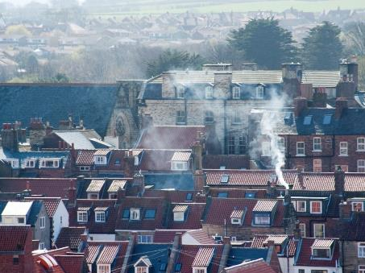
Where does pollution come from?
Notes:
Where might man made pollution come from?
Who can tell me what combustion means?
Who can tell me what fossil fuels are / what do we put in the back of our cars? (petrol / diesel)
What is the air like on the tube? Thick and smoky. It makes the floor and the walls dirty; this is because of the particulate matter (and heavy metal deposits) created by the trains’ brakes as they move along the rails.
Road transport is one of the biggest sources of both greenhouse gases and air pollutants, being responsible for significant contributions to emissions of carbon dioxide, nitrogen oxides, particulate matter (PM10) and (PM2.5). The most common source of pollution in London is from the traffic on our roads. The engines (especially diesel engines) make nitrogen dioxide and the wheels and the brakes make PM pollution. There are 2.6 million privately owned cars in London and many more cars driving through each day.
What are other means of transportation that is negatively affecting air?
Private cars
Passenger transport (land, air, sea and water)
Transport used to carry freight / service
Transport in agriculture
Transport in construction
Transport (ships) used for shipping
Transport used by businesses (deliveries)
Human activities that are major sources of air pollution, include:
Fuel combustion from motor vehicles (e.g. cars and heavy duty vehicles)
Heat and power generation (e.g. oil and coal power plants and boilers)
Industrial facilities (e.g. manufacturing factories, mines, and oil refineries)
Municipal and agricultural waste sites and waste incineration/burning
Residential cooking, heating, and lighting with polluting fuels
Poor urban planning, which leads to sprawl and over-dependence on private vehicle transport, is also a major factor in accelerated pollution emissions.

Slide 7
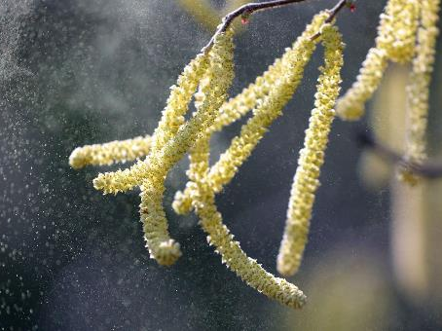
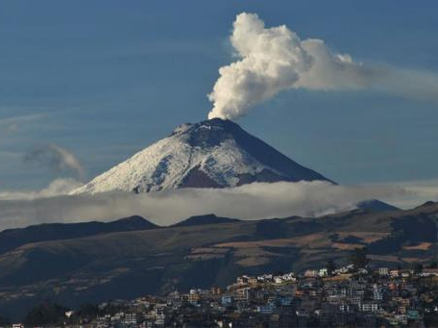
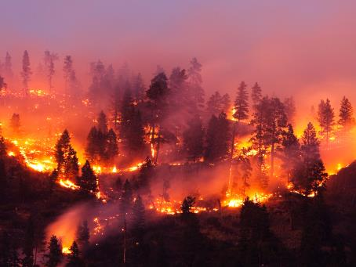
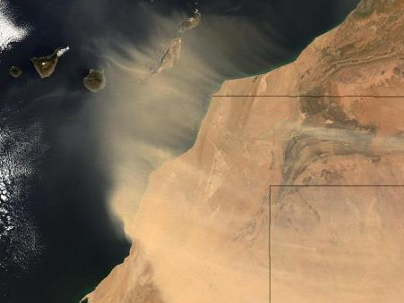
Natural resources of air pollution
Notes:
There are also some natural sources of air pollution.
Where do these pollutants come from?
Who can tell me what’s happening in these pictures?
Mold and allergens from trees, weeds, and grass are also carried in the air, are exacerbated by climate change, and can be hazardous to health. They are not regulated by the government and are less directly connected to human actions, but they can be considered air pollution. Pollen allergies are worsening because of climate change and Climate change also extends the pollen production season because of the warmer temperatures. Even though they are natural they still can be bad for us.

Slide 8
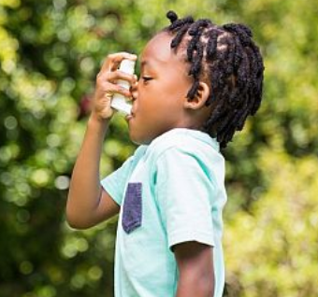
How does air pollution affect our health?
The damage to our health from air pollution can start as early as birth right the way through to old age. It’s estimated that the equivalent of 40,000 lives are lost each year in the UK and five million across the world due to air pollution.
Notes:
Our physical and psychological wellbeing is affected differently by the kind of air pollution we are exposed to causing potential health problems such as:
Respiratory diseases
Cardiovascular damage
Fatigue, headaches and anxiety
Irritation of the eyes, nose and throat
Damage to reproductive organs
Harm to the liver, spleen and blood
Mental health issues
Dementia
Low birth weight leading to premature birth and pregnancy loss.

Slide 9
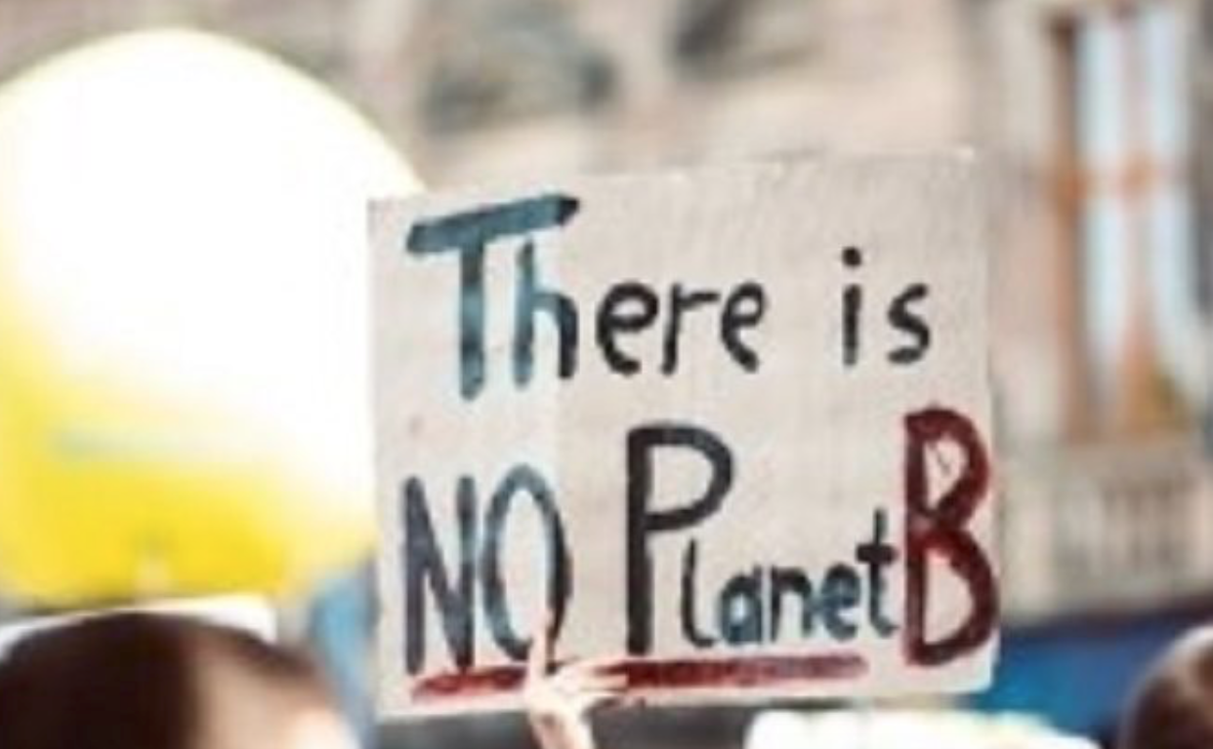
Impacts on the Environment
Notes:
By trapping the earth’s heat in the atmosphere, greenhouse gases lead to warmer temperatures and all the hallmarks of climate change: rising sea levels, more extreme weather, heat-related deaths, and increasing transmission of infectious diseases like Lyme.
More heat alters ice, weather and oceans: a warmer atmosphere causes the planet's snowpack, glaciers and sea and freshwater ice to melt rapidly. Melting glaciers and polar ice sheets contribute to unprecedented sea level rise. Melting sea ice exposes darker ocean waters, which absorb more sunlight than ice – heating the ocean more and speeding up a relentless cycle of melting and heating. The oceans are getting hotter, expanding and becoming more acidic. Weather is getting more extreme. Heatwaves are more frequent worldwide. The increased evaporation of water is like fuel for storms, exacerbating extreme weather events, such as hurricanes. Rising sea levels make storm surges capable of much greater damage. In more naturally arid areas, droughts and wildfires are intensifying.
Human life and prosperity suffer: climate change is a major threat to agriculture. Where, how and when we grow food is vitally connected to our climate's normal patterns. Worldwide, farmers are struggling to keep up with shifting weather patterns and increasingly unpredictable water supplies. Farms are more likely to face attacks from weeds, diseases and pests, which affect yield. Extreme events also threaten crop yields, such as through flooding or reduced water supply. A warmer atmosphere increases the formation of ground-level ozone – also known as smog – in polluted regions. Smog irritates lungs and triggers asthma attacks. Smoke from wildfires further degrades the air. Extreme summer heat means more deaths during heatwaves. Warmer freshwater makes it easier for disease-causing agents (such as bacteria) to grow and contaminate drinking water.
Natural habitats become hostile or extinct: habitats on land and in the sea are changing, making them inhospitable for some species, while letting others move in and take over. Some ecosystems are at risk of collapsing.The ice Arctic animals need is vanishing. As sea ice disappears, ice-dependent mammals such as walruses and polar bears struggle to survive. In 2008, the polar bear became the first animal to make the Endangered Species Act list of threatened species because of global warming. Coral reefs are highly sensitive to small changes in ocean temperatures. The heat stresses the algae that nourish the corals and provide their vibrant colors. The algae then leave, and the corals eventually starve – an event known as bleaching. As coral reefs are home to many other species, such as fish, their collapse would disrupt the entire ecosystem. Also, a more acidic ocean affects the normal calcium balance, meaning creatures with calcified shells, such as shellfish and coral, may not have enough calcium to grow. Forests are more prone to deadly infestations. Milder winters and longer summers allow tree-killing insects to thrive. Meanwhile, trees weakened by prolonged drought have lower defense mechanisms. This cycle of warmer weather, weak trees and thriving insects could eventually kill our forests.

Slide 10
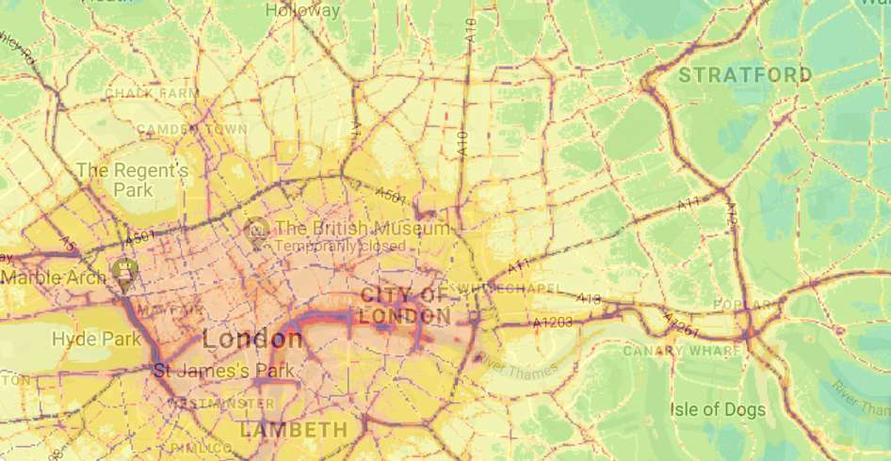
Air pollution in London
Notes:
What does this map show us? (it is a map of London. It is showing us where the pollution is and the colors show how bad the pollution is. What we really want is this map to be coloured in either light or even better dark blue).
Talk about the scale and what it shows.
What is NO2?
Who can remember the types of pollutants we were talking about earlier? If CO2 is carbon dioxide then NO2 is nitrogen dioxide.
What do you think these little lines are? (roads)
It is roads that have the highest pollution in London. Why do you think that is?
(can talk about legal WHO limits which currently is 40 and on the map, the level of air pollution almost everywhere exceeds and is above 40). This map shows us that the most dangerous source of pollution is roads and the traffic on them.

Slide 11
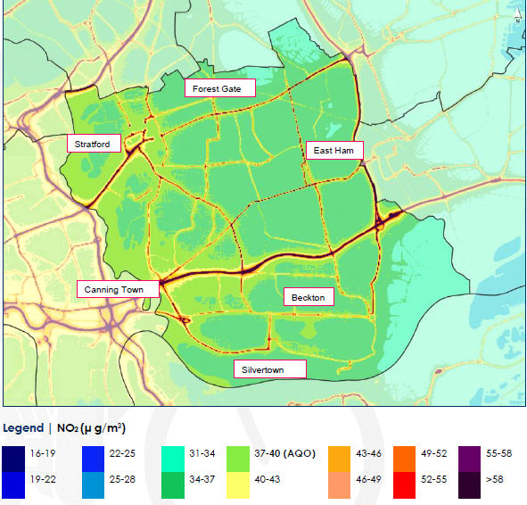
Air Pollution in Newham
Notes:
Similar map to that in the above slide, just localised for Newham. Explain that redlines represent high levels of pollution. Ask if children can recognise where the school is located / where they live.
The modelled map predicts that NO2 concentrations are exceeding the national air quality objective (AQO) for the protection of human health (40 μg/m3) in the locality of all major roads in the across the borough.
Newham residents are exposed to higher particulate pollution than in any other London Borough causing the highest number of child asthma hospital admissions.
Newham has the highest population exposure to PM2.5 in London due to road traffic, prominence of flats above shops and Victorian terraced properties with small front gardens. The town centres of Stratford, East Ham, Forest Gate and Canning Town are particularly affected.

Slide 12
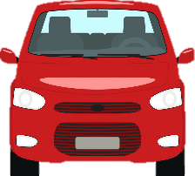
How can we protect ourselves from road traffic pollution?
Emissions concentration
Distance from source
Notes:
Introduce the concept of exposure. Being closer to the source of pollution means that you are breathing more of it in. Pollution is much higher when you are closer to the exhaust of a car. Being even one meter further away can mean that we are breathing much cleaner air. This is why pollution from cars disproportionately effects young people. Children also breathe at a faster rate than adults so you are taking more breaths each minute and might be inhaling more pollution. Because your lungs and hearts are still developing / growing it is really important that you are note exposed to high levels of pollution especially when that pollution is easily avoidable.
Who knows the word that we use to describe a car that is not moving but still has it’s engine running. It starts with ‘i’. (they usually say ignition.
Idling
When something is idle it is not doing anything so when a car has its engine on, making pollution, but it isn’t going anywhere we say that it is idling.
Why might idling be really bad? It makes pollution collect in one place. An idling car makes up to 20 times the pollution of a moving car and most of the time cars are idling for no reason. An Idling car creates enough exhaust (the gas that comes out the back of the car) to fill 150 balloons in a minute.

Slide 13
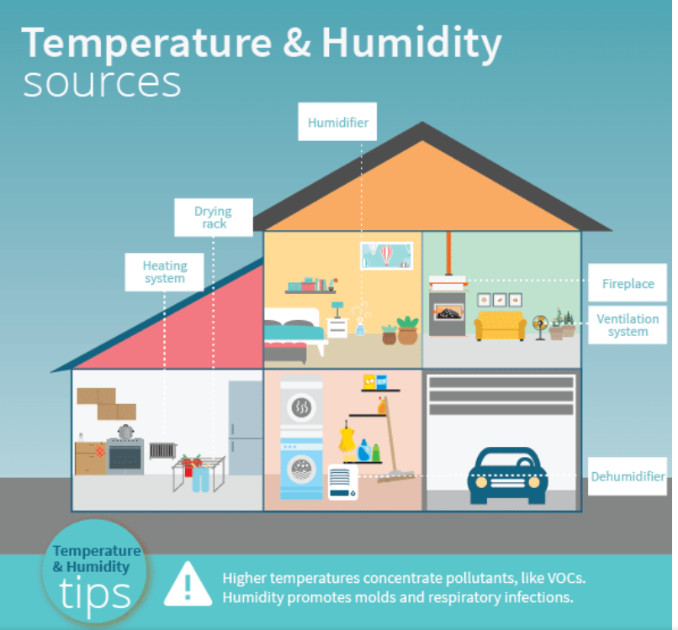
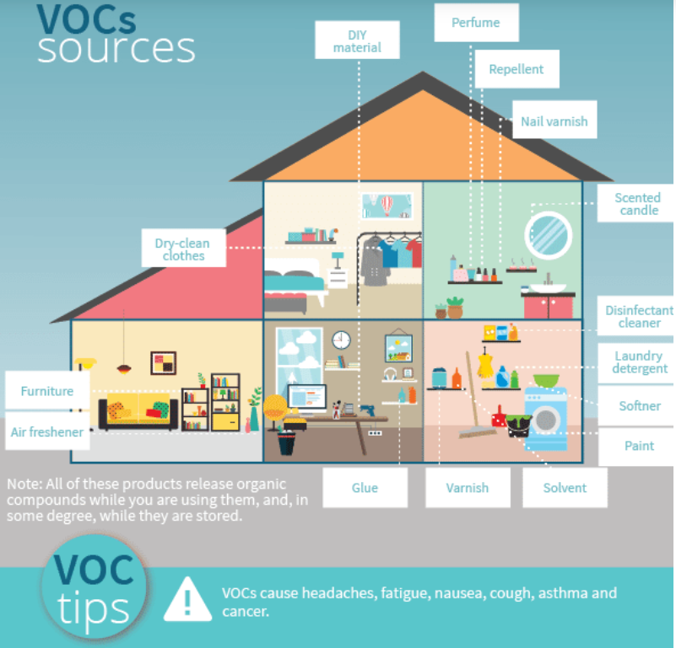
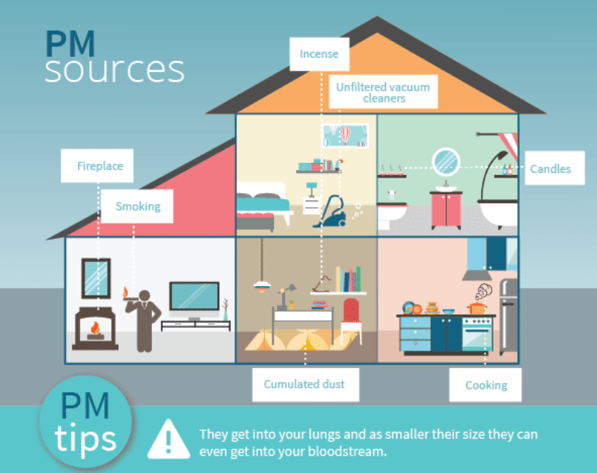
How can we protect ourselves from indoor pollution?
Notes:
Ventilate your home - open windows and use extractor fans when cooking or using cleaning products, but close windows near busy roads during rush hours
Use fragrance-free milder cleaning products
Only burn dry, well-seasoned wood or smokeless fuel on your stove, open fire or barbeque
Choose paints and varnishes that are labelled low volatile organic compounds (VOCs).

Slide 14
Think of other, healthier travel options…
Notes:
Hands up for ideas
Share lifts to school
Walk or cycle to school (ACTIVE TRAVEL *introduce term*)
Park and stride
Walk a quieter route

Slide 15
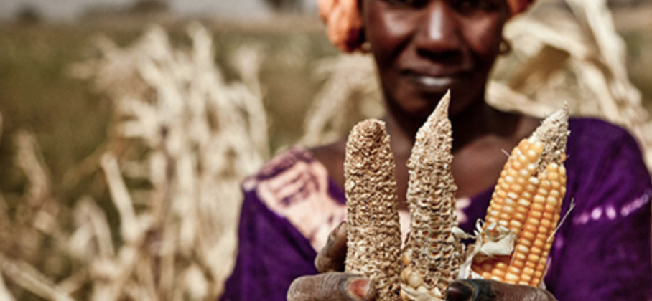
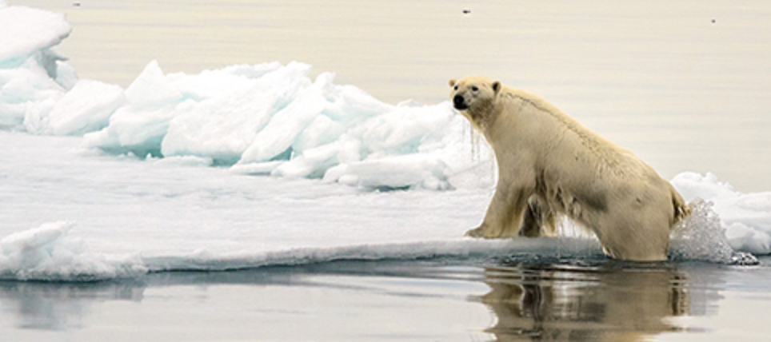
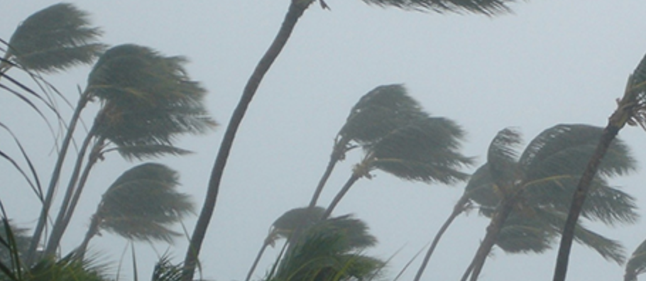
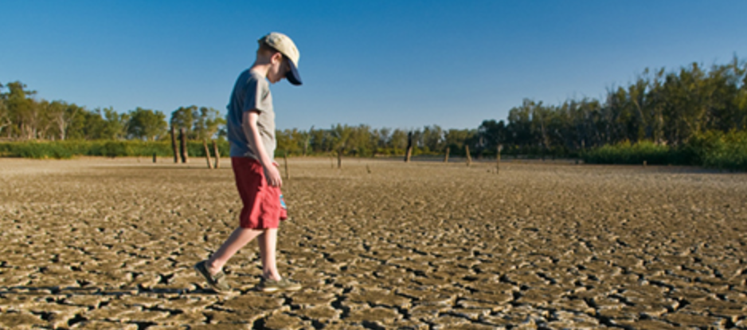
How you can help reduce air pollution and protect the environment?
Notes:
There are number of behavioural changes and steps you can take to help to improve air quality:
Walk and cycle more for short journeys
Use public transport wherever possible
Avoid short journeys by car or public transport
Car share, particularly on popular journeys such as the school run
Eat less meat and dairy products
Buy local produce if possible and available
Save energy and always turn off the light when you leave the room
Compost garden waste, don’t burn it – bonfires cause air pollution
Recycle
Plant hedges around the school
Talk to others about pollution

Slide 16
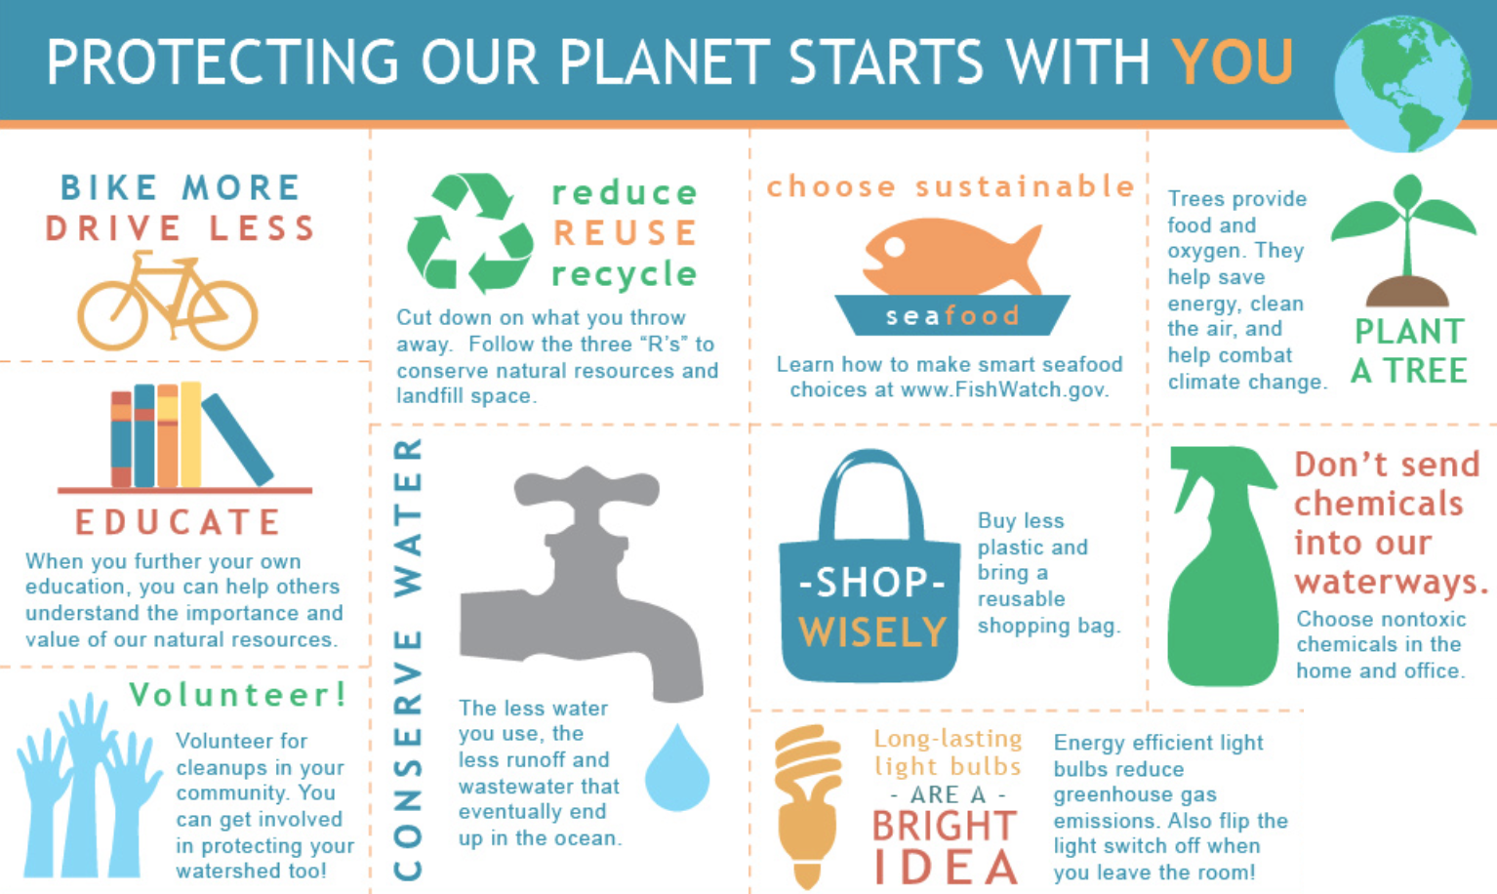
People at the Heart of Everything We Do
Notes:
Make good choices about transportation. When you can, walk, ride a bike, or take public transportation, and when you are older and perhaps the most important - support leaders who push for clean air and water and responsible steps on climate change.

Slide 17
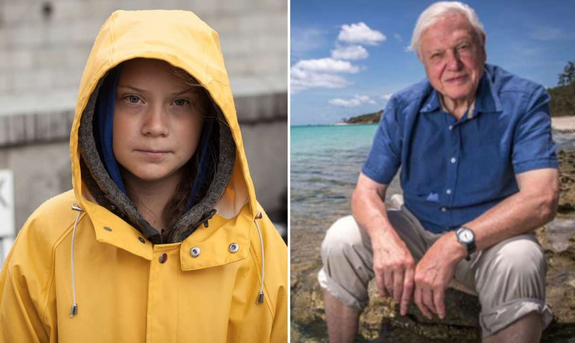
Think about ways how you can contribute to help the environment?
Greta Thunberg and Sir David Attenborough
Notes:
Write a short essay on actions you think you can take today to make a difference.

