Slide 1
About Compost London
About One Newham
Compost exists to support Voluntary and Community Sector groups to grow, develop and thrive through a catalogue of expert support.
One Newham is a partnership network for the voluntary, community and faith sector.
We believe that everyone gains when we work together: organisations grow stronger, services become more responsive and people find their power. Our vision is of Newham as a place where people, organisations and services all collaborate to build fairer and stronger communities.

Slide 2
Working with Universities and Researchers
1. What do you want to get out of the arrangement?
Something done for you
Something done to your organisation
A knowledge exchange
2. Make this clear from the outset.
Have a vision of the end result and share this
Explain the parameters you are working with - time, availability, access
Don’t just expect things to happen – do an induction, fill in background information and check in.

Slide 3
Values needed on both sides
Understanding of each others worlds and the pressures they are operating with
Respect for each others knowledge and expertise
Willingness to learn from each other
Need to produce something useful for all needs

Slide 4
Benefits of working with Universities and researchers
New ideas and ways of looking at things
Latest thinking around your area of work
Staff and volunteers see a different way of working
Rigorously tested evidence and analysis
Interested people as potential volunteers or organisational champions

Slide 5
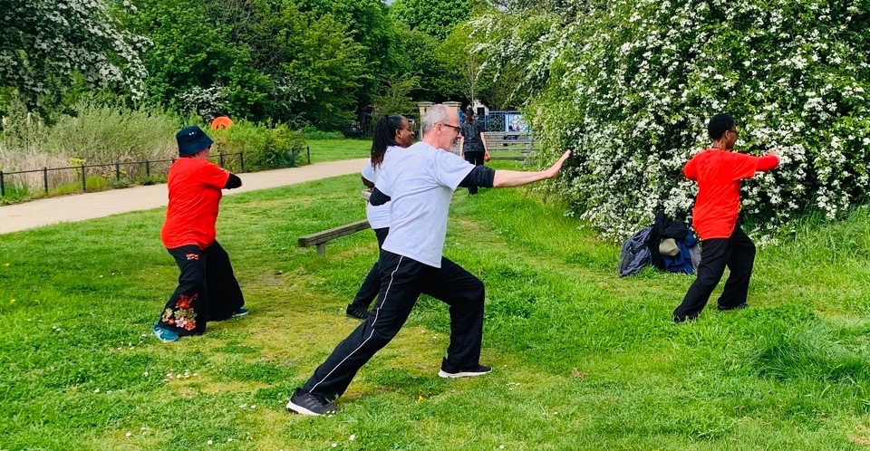
Research How can the NHS / local GP’s engage more effectively with grass roots organisations
What are the priorities - at organisational level & for residents
What change needs to happen that can have the most impact in the shortest time frame?

Slide 6
Potential Research Questions
1. Effectiveness of Policies: How effective are existing health and care equity policies? What indicators can be used to measure their impact on marginalized communities?
2. Access and Inclusivity: What strategies or policies can we implement to ensure equitable access to services for diverse populations, including marginalized groups?
3. Health Disparities: What are the specific health disparities prevalent among different socio-economic, ethnic, or geographic communities? How can we address these disparities through policy and practice?
4. Community Engagement: How can we actively engage with local communities to understand their specific health needs and preferences? How can this engagement inform policy decisions and service delivery?

Slide 7
5. Policy Implementation Challenges: What are the challenges in implementing equity-focused policies? Are there systemic or structural barriers hindering the effective implementation of these policies?
6. Evaluation of Interventions: How can the effectiveness of interventions aimed at improving health equity be evaluated? What metrics or methodologies can be used to assess the success of these interventions?
7. Role of Education and Training: What role does education and training play in promoting equity within health and care? How can training programs be designed to increase cultural competency among healthcare providers?
8. Policy Impact on Health Outcomes: How do equity policies and practices directly impact health outcomes among underserved communities? Are there notable improvements or challenges observed due to these policies?

